Slide 1

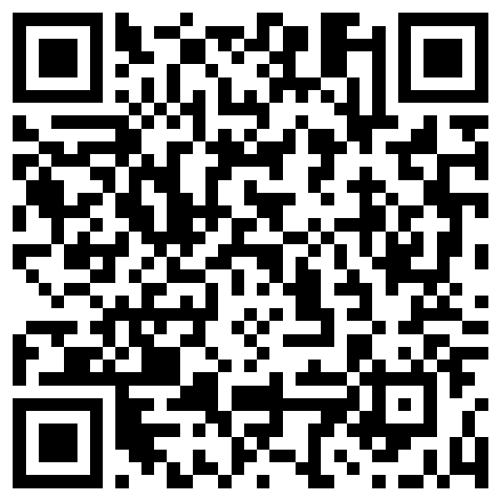
Understanding complex situation descriptions
Aaron Steven White
University of Rochester
Keynote
NALOMA
4 August 2025

Slide 2
What we do
We use natural language to convey information about situations: things that happen or stuff that is true.

Slide 3
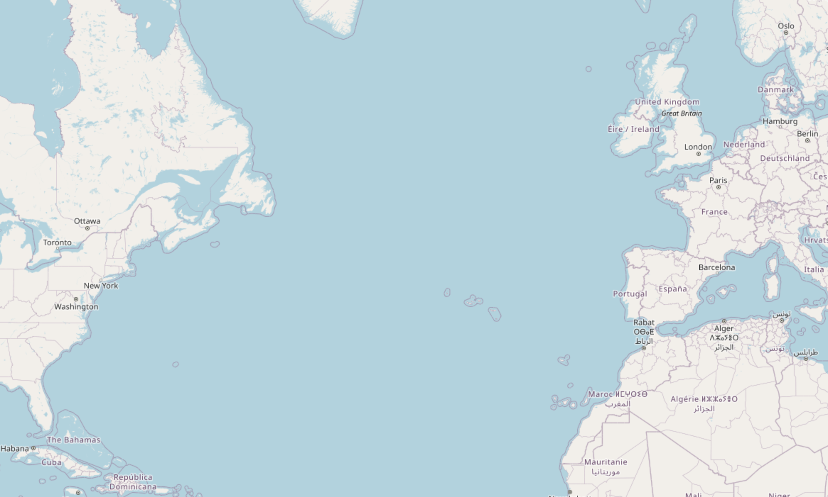
I traveled from Rochester to Bochum yesterday.

Slide 4
What we do
We use natural language to convey information about situations: things that happen or stuff that is true.
How we do this
Systematic relationships between the way we conceptualize situations and the way we describe them.

Slide 5
I traveled from Rochester to Bochum yesterday.
I traveled from Rochester to Bochum yesterday.

Slide 6
What we do
We use natural language to convey information about situations: things that happen or stuff that is true.
How we do this
Systematic relationships between the way we conceptualize situations and the way we describe them.
What this allows us to do
Draw inferences that go beyond what one strictly says in describing a situation.

Slide 7
I traveled from Rochester to Bochum yesterday.
I traveled from Rochester to Bochum yesterday.
I was in Bochum yesterday.
I was in Rochester before I was in Bochum.
I changed location over the course of the travel.

Slide 8

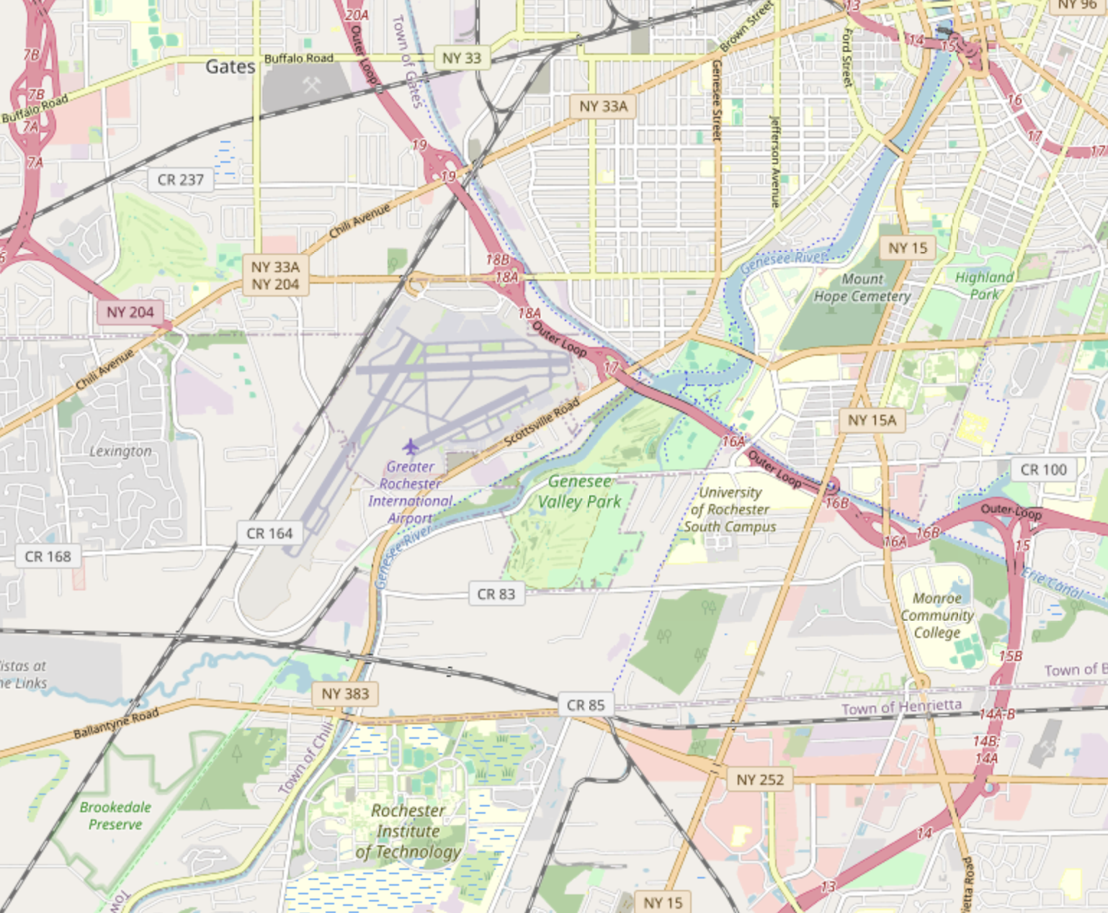
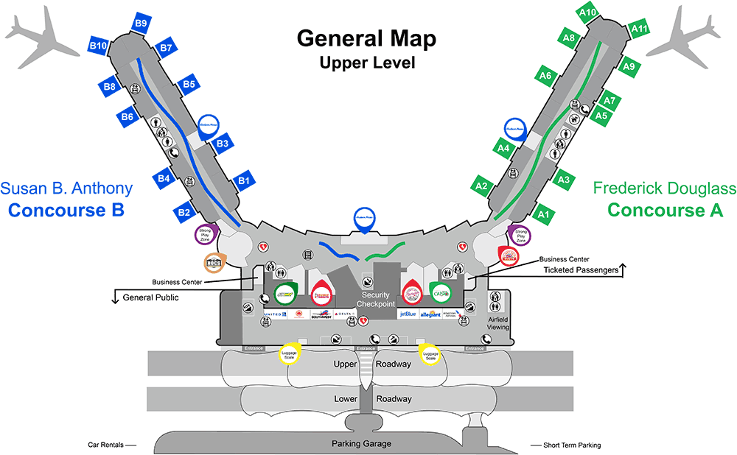
I traveled from Rochester to Bochum yesterday.
I traveled from Rochester to Bochum yesterday.
I took a flight yesterday.
I traveled to the Rochester airport yesterday.
I went through airport security at the Rochester airport yesterday.

Slide 9
Question
How do we design systems that capture the inferences we draw about situations based on their descriptions?
Ontology-factored approach
Map situation description to symbolic situation ontology and draw inferences using rules stated over that ontology.

Slide 10
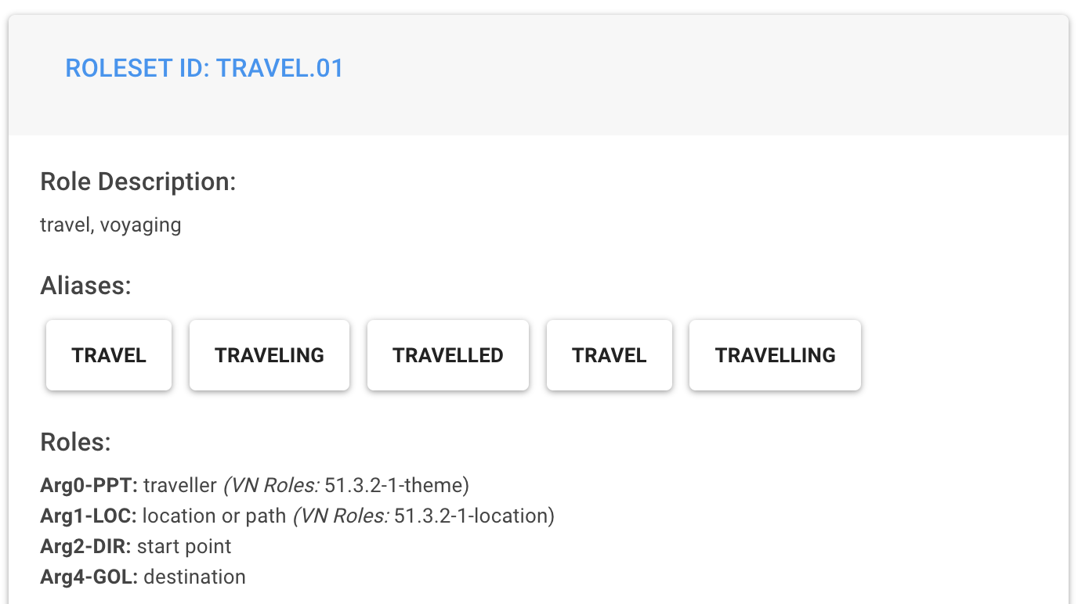
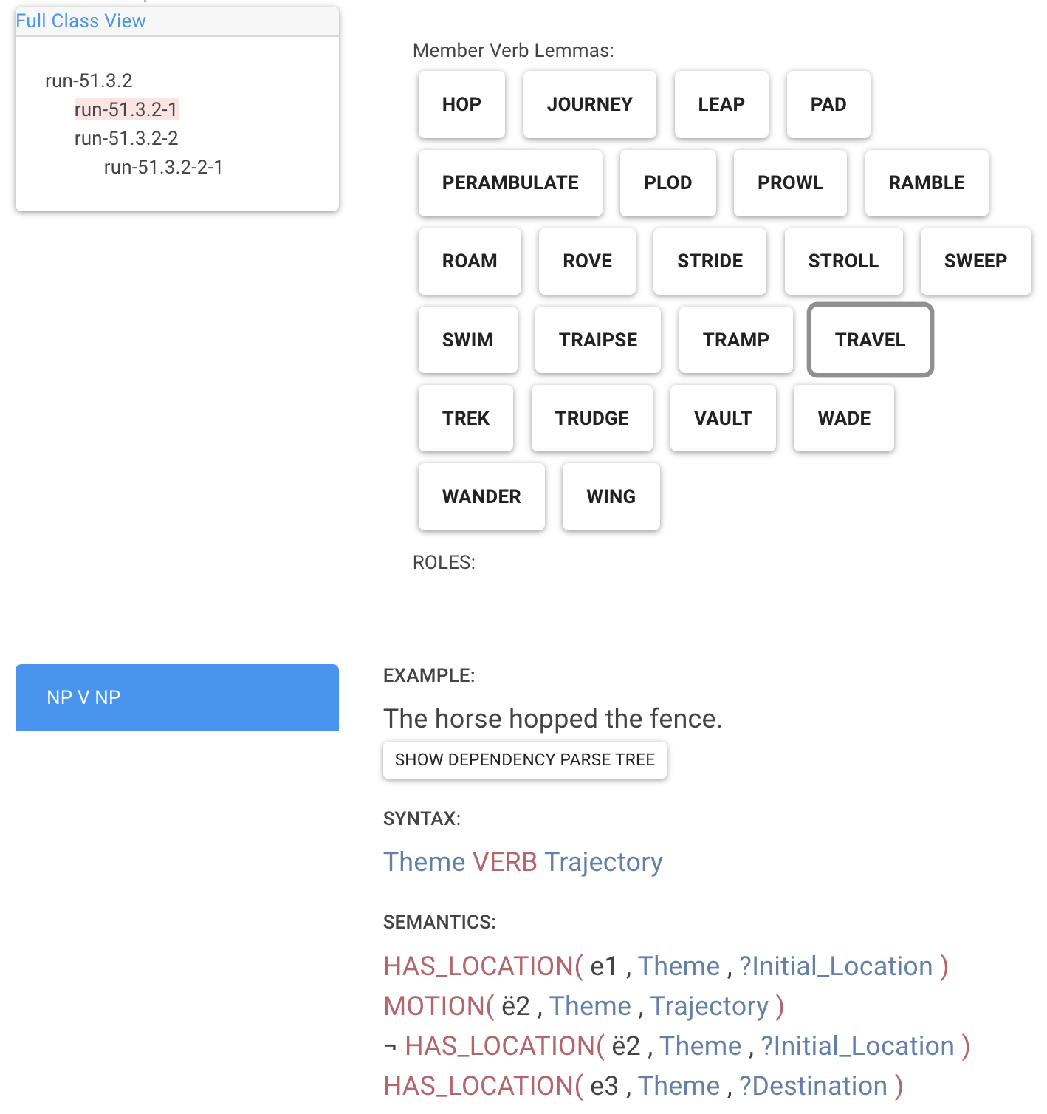
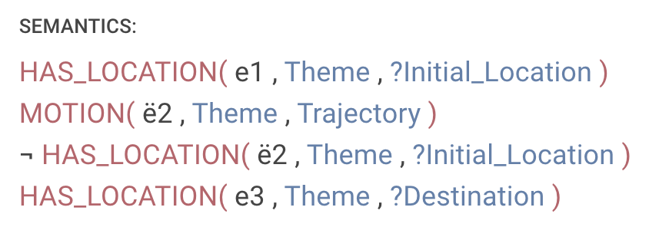
I traveled from Rochester to Bochum yesterday.
Uniform Meaning
Representation
Van Gysel et al. 2021
PropBank
Palmer et al. 2005
travel-01
temporal
yesterday
aspect
PARTICIPANT0
PARTICIPANT2
PARTICIPANT4
VerbNet
Kipper-Schuler 2005
process
person
region
region
ref-person
name
name
1st
ref-number
Rochester
singular
Bochum
Aaron was in Rochester yesterday.

Slide 11
Challenge #1: Expense
Annotated corpora are expensive to build and maintain because they require highly trained experts.
Challenge #2: Brittleness
Ontologies do not easily capture the ways in which context modulates the inferences that we draw.

Slide 12
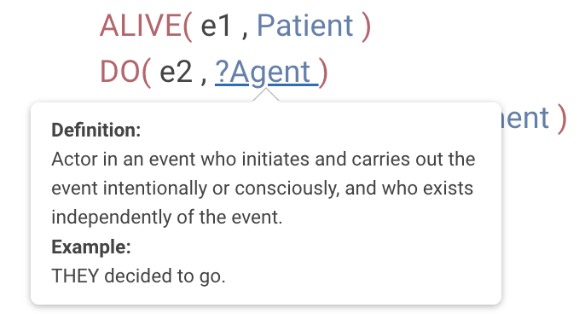
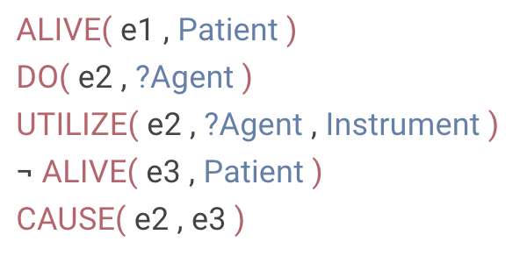
An assassin in Colombia killed a federal judge on a Medellin street.
The antibody then kills the cell.
She was untrained and, in one botched job, killed a client.
x
?
The assassin chose to be involved in killing the judge.
The antibody chose to be involved in killing the cell.
She chose to be involved in killing the client.
Reisinger et al. 2015

Slide 13
Question
How do we design systems that capture the inferences we draw about situations based on their descriptions?
Ontology-factored approach
Map situation description to symbolic situation ontology and draw inferences using rules stated over that ontology.
Ontology-free approach
Map situation descriptions to natural language strings expressing the inferences of interest.

Slide 14
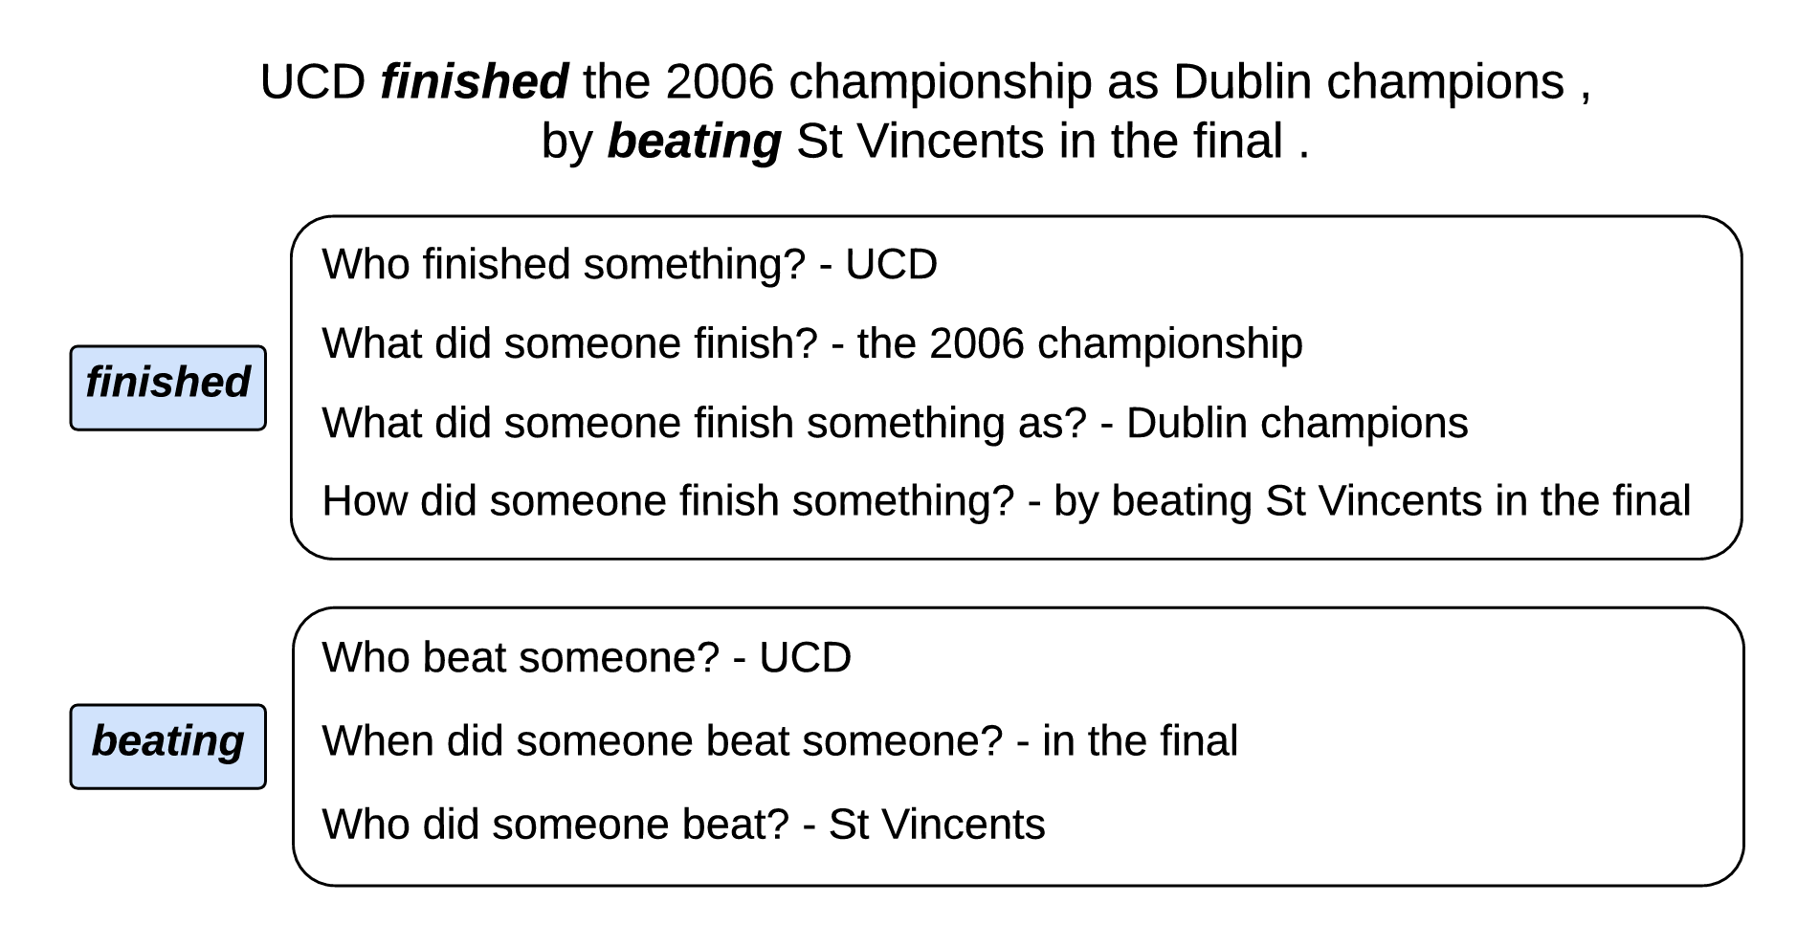
QA-SRL/QAMR
He et al. 2015, Michael et al. 2018

Slide 15
Challenge #1: Lack of Abstraction
Inferences we can draw by templatizing a string don’t provide information beyond that already in the string.
Key Idea: Representational Scaffolding
Ontologies provide guidance about what the interesting inferences are; that guidance undergirds multiple tasks.

Slide 16
Part 1: Natural Language Inference
Leverage ontology descriptions to generate natural language inference templates filled by semantic parses.

Slide 17
An assassin in Colombia killed a federal judge on a Medellin street.
The antibody then kills the cell.
She was untrained and, in one botched job, killed a client.
x
?
Participant
Participant
Participant
The assassin chose to be involved in killing the judge.
The antibody chose to be involved in killing the cell.
She chose to be involved in killing the client.
Situation
Situation
Situation
Reisinger et al. 2015

Slide 18
Challenge #2: Too Much Abstraction
The inferences are interesting and broadly applicable but limited in their specificity.

Slide 19
Part 1: Natural Language Inference
Leverage ontology descriptions to generate natural language inference templates filled by semantic parses.
Part 2: Template Filling
Leverage ontology structure to fill natural language templates across documents describing same event.

Slide 20
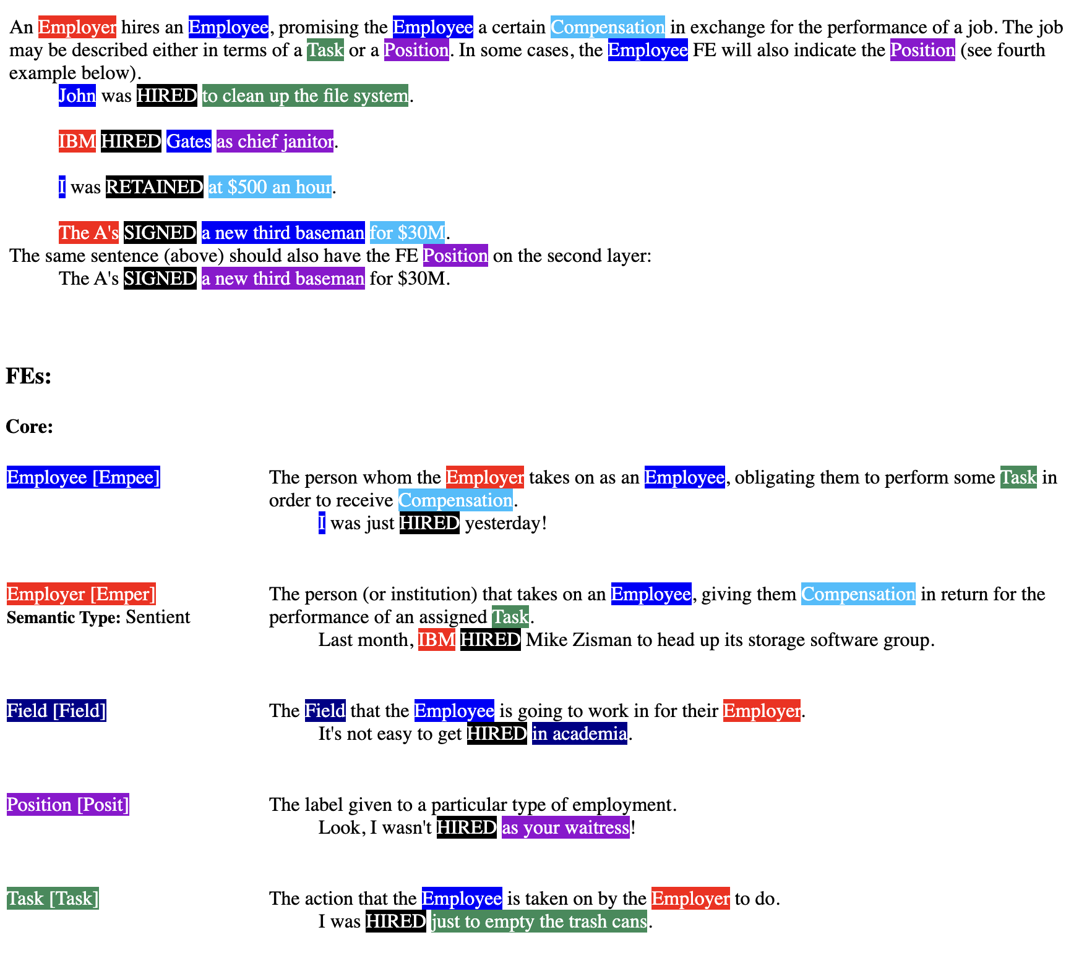
FrameNet Baker et al. 1998
Transitive_action
Intentionally_act
inheritance
inheritance
Employment_scenario
Intentionally_affect
subframe
perspective on
inheritance
Employment_start
Employment_continue
Employment_end
Employer_scenario
perspective on
precedes
precedes
Get_a_job
Being_employed
Quitting
precedes
precedes
subframe
subframe
subframe
Hiring
Employing
Firing
precedes
precedes

Slide 21
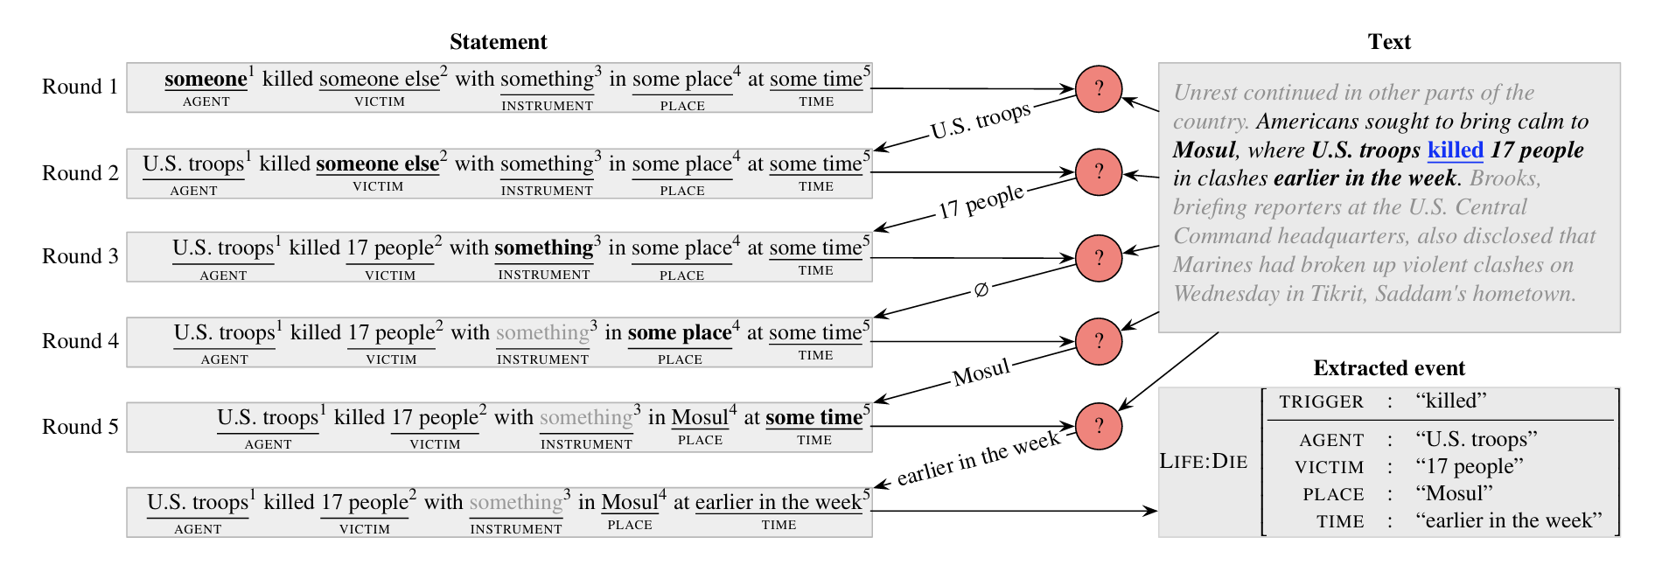
“Reading the (annotation) manual”
Chen et al. 2020

Slide 22
Challenge #2: Too Much Abstraction
The inferences are interesting and broadly applicable but limited in their specificity.
Challenge #3: Not Enough Context-Sensitivity
Inferences are interesting and specific but lack sensitivity to the context of the situation description.

Slide 23
Part 1: Natural Language Inference
Leverage ontology descriptions to generate natural language inference templates filled by semantic parses.
Part 2: Template Filling
Leverage ontology structure to fill natural language templates across documents describing same event.
Part 3: Event-Keyed Summarization
Use semantic parse to propose events of interest and synthesize info about those events across documents.

Slide 25
Natural Language Inference

Slide 26
Idea
Inferences relevant to mapping from concepts to linguistic structure tend to be inferences humans really care about.
Example #1: Linking Theory
PARTICIPANT₁
SUBJECT
SITUATION
PARTICIPANT₂
PREDICATE
OBJECT
PARTICIPANT₃
OBLIQUE
concept
structure

Slide 27
Natural Language Inference
Sentence-Level Descriptions

Slide 28
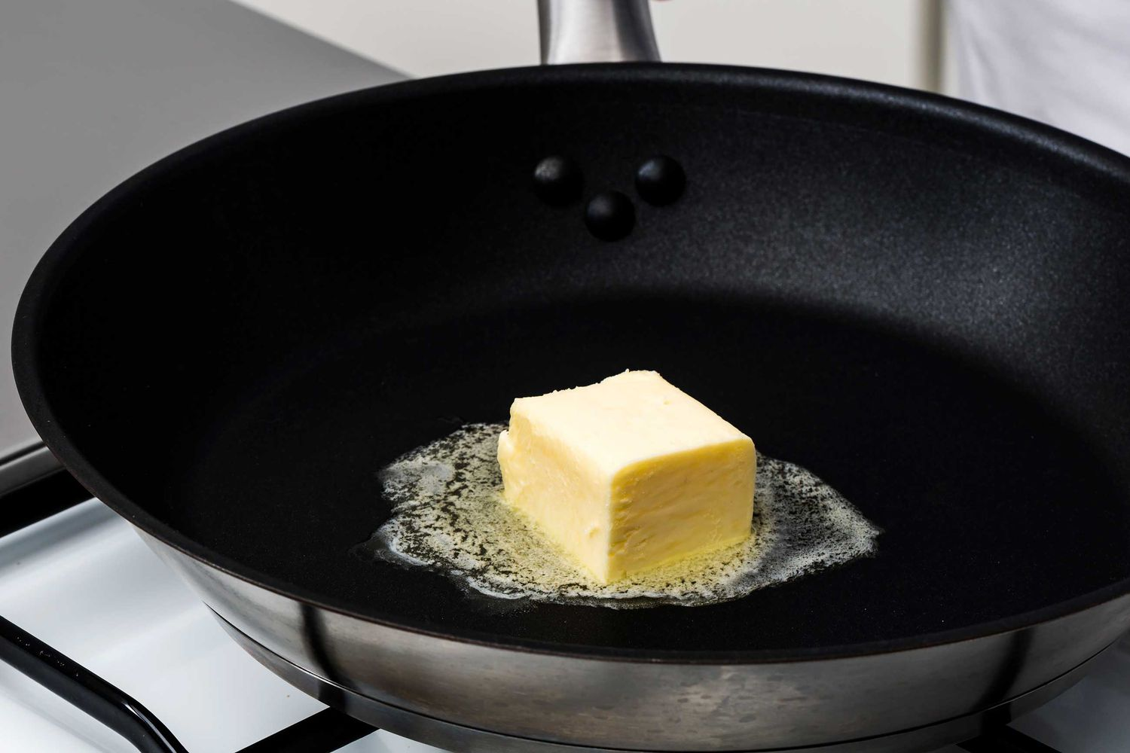
MELT
MELTER
MELTEE
MELT-WITH
The chef melted the butter.
The butter melted.
The chef melted the butter with a steady low heat.
A steady low heat melted the butter.
The butter melted the chef.
???
Fillmore 1970, Levin 1993

Slide 29
MELT
MELTER
MELTEE
MELT-WITH
AGENT
PATIENT
INSTRUMENT
subject
subject
object
object
oblique
subject
subject
object
subject
object
The chef melted the butter with a steady low heat.
A steady low heat melted the butter.
The butter melted the chef.
The chef melted the butter.
The butter melted.
Fillmore 1970, Levin 1993

Slide 30
MELT
MELTER
MELTEE
MELT-WITH
AGENT
PATIENT
INSTRUMENT
MELTER is volitional in MELT.
MELTEE changes in MELT.
MELT-WITH is used to MELT.
Dowty 1991

Slide 31
Dowty’s idea
Having more prototypically agentive properties compared to other roles makes a role more likely to map to SUBJ.
Upshot
Inferences relevant to linking theory are probably ones humans tend to care a lot about.

Slide 32
PARTICIPANT chose to be involved in SITUATION.
PARTICIPANT caused SITUATION to happen.
Protoagent
PARTICIPANT was aware of being involved in SITUATION.
PARTICIPANT changed location during SITUATION.
PARTICIPANT existed before SITUATION began.
PARTICIPANT existed during SITUATION.
PARTICIPANT existed after SITUATION stopped.
PARTICIPANT changed possession during SITUATION.
PARTICIPANT was used in carrying out SITUATION.
PARTICIPANT was changed or somehow altered during or by the end of SITUATION.
Protopatient
SITUATION happened for the benefit of PARTICIPANT.
The change in PARTICIPANT happened throughout the SITUATION.
Only a part or portion of PARTICIPANT was involved in SITUATION.
Dowty 1991, Reisinger et al. 2015, White et al. 2016

Slide 33
Two steps
Find relevant SITUATION-PARTICIPANT pairs.

Slide 34
PARTICIPANT chose to be involved in SITUATION.
Hiller chose to be involved in the asking.
Bush chose to be involved in the asking.
White et al. 2016, 2020, Zhang et al. 2017

Slide 35
Two steps
Find relevant SITUATION-PARTICIPANT pairs.
Requirement
Very light scaffolding ontology including at least SITUATION, PARTICIPANT, and RELATION.

Slide 36
relation
participant
situation
Similar to OpenIE
Banko et al. 2007
White et al. 2016, 2020, Zhang et al. 2017

Slide 37
Rule-based approach
White et al. 2016, Zhang et al. 2017
based on Rudinger and Van Durme 2014
A set of rules defined on top of Universal Dependencies syntactic annotations.

Slide 38
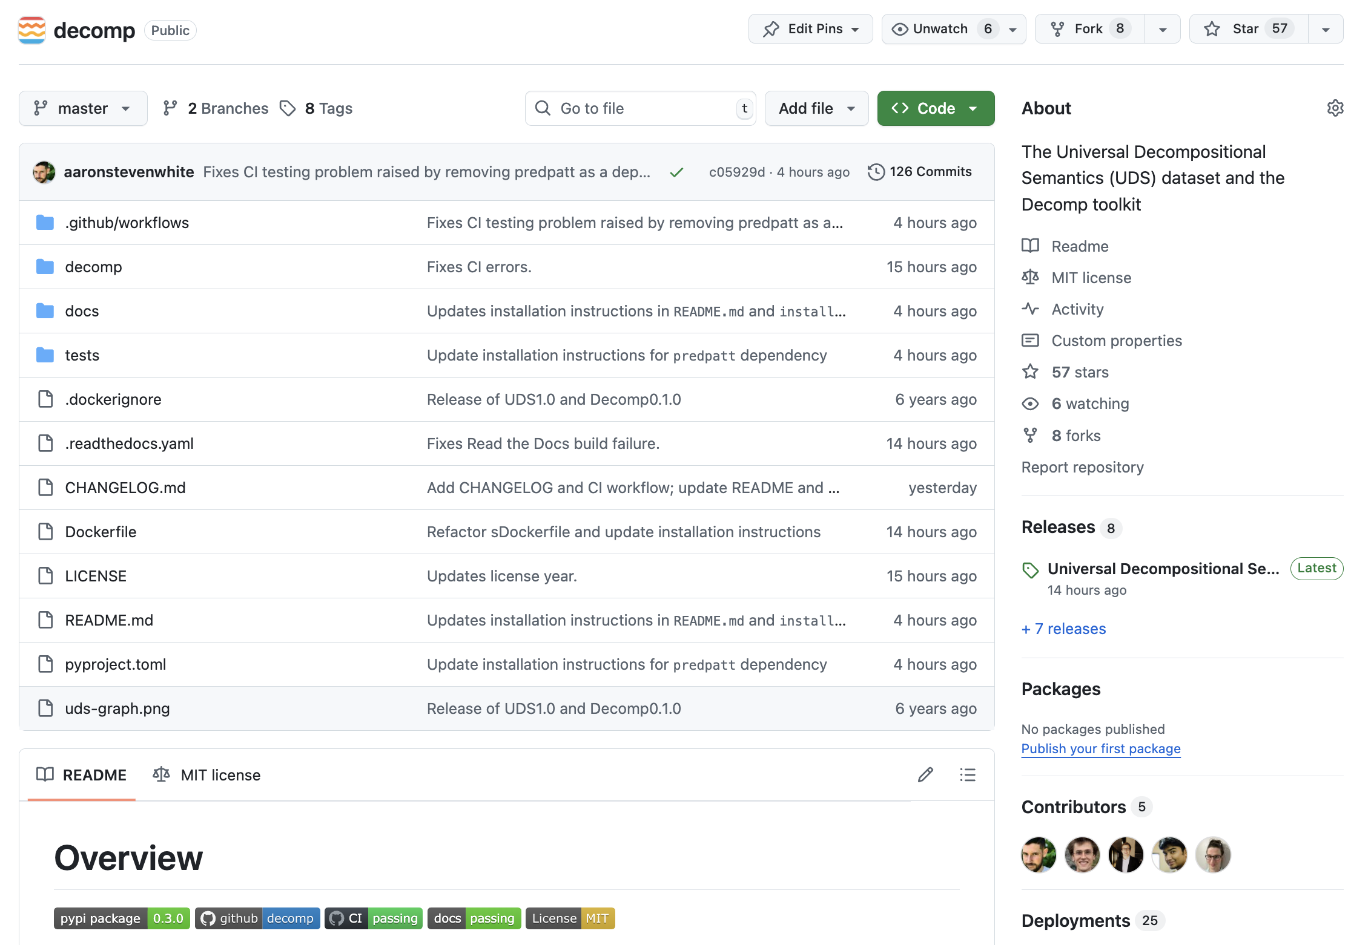
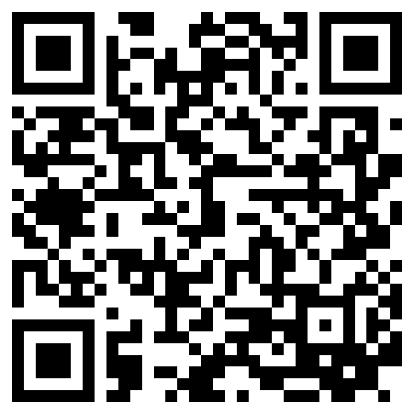
https://github.com/decompositional-semantics-initiative/decomp/
White et al. 2020

Slide 39
Rule-based approach
White et al. 2016, Zhang et al. 2017
based on Rudinger and Van Durme 2014
A set of rules defined on top of Universal Dependencies syntactic annotations.
Transductive parsing approach
Stengel-Eskin 2020, 2021
based on Zhang et al. 2019
Encoder-decoder networks that take raw sentence and produce semantic graph on the decoder side.

Slide 40
Two steps
Find relevant SITUATION-PARTICIPANT pairs.
Figure out which inferences hold of which pairs.
Requirement
Very light scaffolding ontology including at least SITUATION, PARTICIPANT, and RELATION.

Slide 41
PARTICIPANT chose to be involved in SITUATION.
Hiller chose to be involved in the asking.
Bush chose to be involved in the asking.
White et al. 2016, 2020, Zhang et al. 2017

Slide 42
Hiller asked Bush to name the leaders of Chechnya, Taiwan, India, and Pakistan.
How likely is it that Hiller chose to be involved in the asking?
very unlikely
somewhat unlikely
not enough information
somewhat likely
very likely
Reisinger et al. 2015, White et al. 2016, 2020, Zhang et al. 2017

Slide 43
Hiller asked Bush to name the leaders of Chechnya, Taiwan, India, and Pakistan.
How likely is it that Bush chose to be involved in the asking?
very unlikely
somewhat unlikely
not enough information
somewhat likely
very likely

Slide 44
Data
White et al. 2016
~10k predicate-argument pairs from Penn TreeBank +
~6k predicate-argument pairs from Universal Dependencies English Web Treebank.

Slide 45
Challenge
Semantic parses are sentence-bound, meaning it’s hard to capture information about complex situations.
Approach
Vashishtha et al. 2019, Gantt et al. 2022
Augment light scaffolding with cross-sentential relations and construct inference templates for those relations.

Slide 46
Natural Language Inference
Document-Level Descriptions

Slide 47
Idea
Inferences relevant to mapping from concepts to linguistic structure tend to be inferences humans really care about.
Example #2: Event Structure
SUBSITUATION₁
CLAUSE₁
PREDICATE
SITUATION
SUBSITUATION₂
CLAUSE₂
CONTAINER
SUBSITUATION₃
CLAUSE₃
concept
structure

Slide 48
The chef began to make the roux.
ROUX-MAKING
Before adding the flour, she melted the butter.
Making the roux took some amount of time.
Adding the flour was part of making the roux.
Melting the butter ended before adding the flour started.

Slide 49
Idea #1
Vendler 1957
Situations fall into classes based on their temporal progression.
Idea #2
These classes can be decomposed in terms of the inferences they trigger about their temporal progression and the relations among their subevents.
Kenny 1963, Lakoff 1965, Verkuyl 1972, Bennett and Partee 1978, Mourelatos 1978, Dowty 1979, Jackendoff 1990, Pustejovsky 1995, i.a.

Slide 50
The chef began to make the roux. Before adding the flour, she melted the butter. While she gently stirred the mixture, one of her sous chefs cracked an egg. The other stood and watched.
The melting took some amount of time.
The stirring took some amount of time.
The cracking was instantaneous.
The standing took some amount of time.

Slide 51
The chef began to make the roux. Before adding the flour, she melted the butter. While she gently stirred the mixture, one of her sous chefs cracked an egg. The other stood and watched.
The melting had a natural endpoint.
The cracking had a natural endpoint.

Slide 52
The chef began to make the roux. Before adding the flour, she melted the butter. While she gently stirred the mixture, one of her sous chefs cracked an egg. The other stood and watched.
The melting was dynamic.
The stirring was dynamic.
The cracking was dynamic.

Slide 53
SITUATION lasted TIME-UNIT.
SITUATION was dynamic.
Event internal
SITUATION had natural parts.
Parts of SITUATION are similar to each other.
Parts of SITUATION lasted TIME-UNIT on average.
Event mereology
SITUATION1 was part of SITUATION2.
SITUATION2 was part of SITUATION1.
SITUATION1 started before SITUATION2 started.
Temporal relations
SITUATION1 ended before SITUATION2 started.
SITUATION1 started before SITUATION2 ended.
SITUATION1 ended before SITUATION2 ended.
Govindarajan et al. 2019, Vashishtha et al. 2019, 2020, Gantt et al. 2022

Slide 54
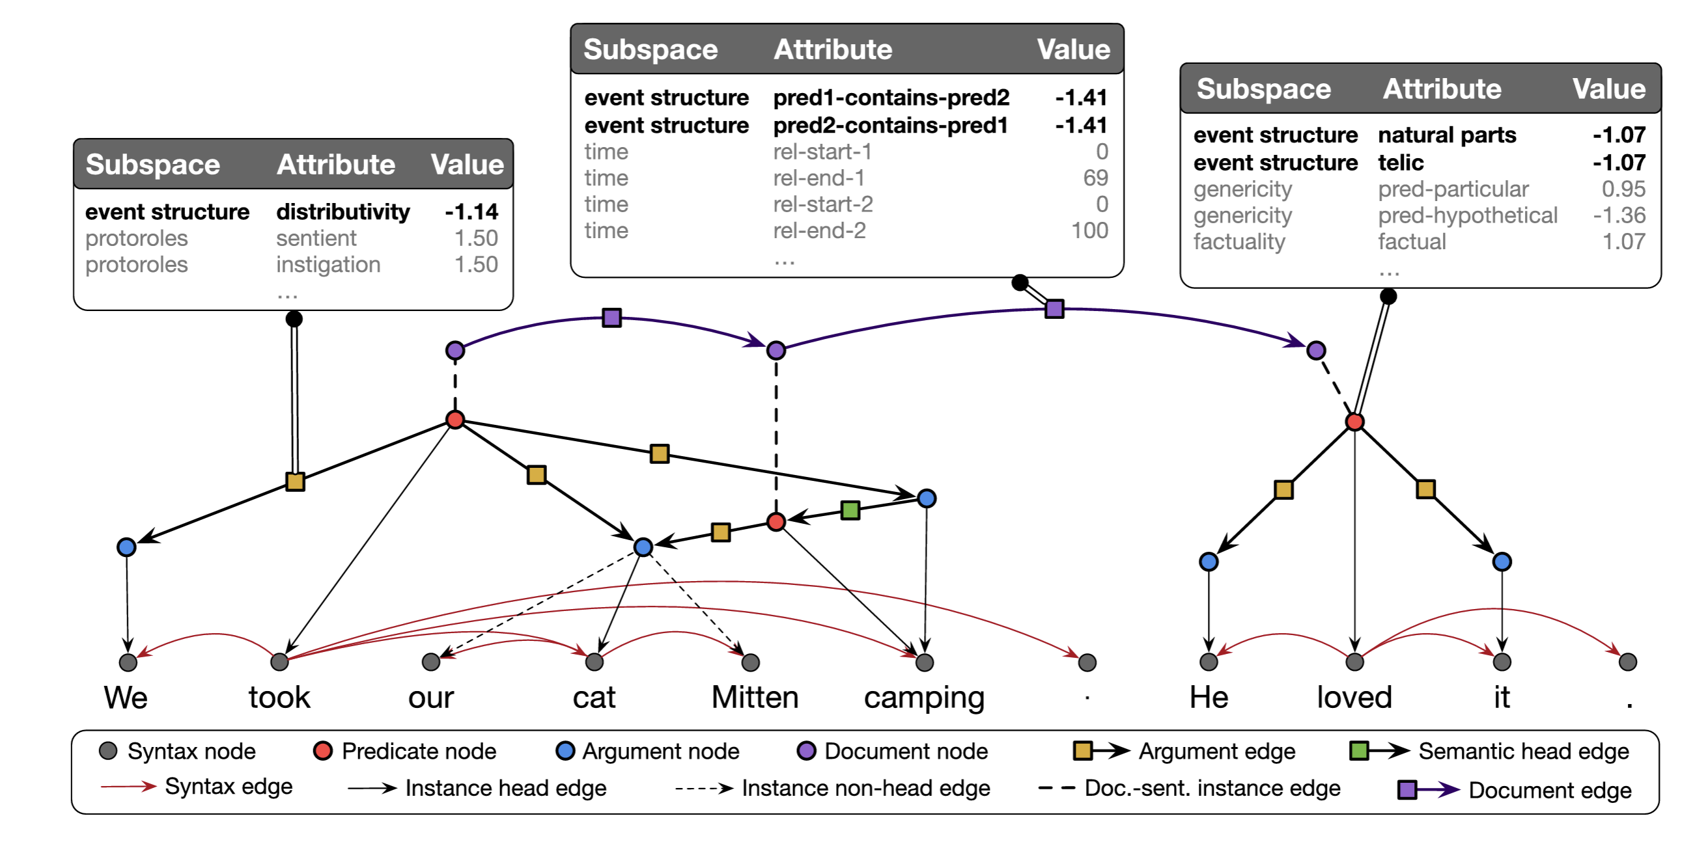

Slide 55
Data
~32k predicates from UD-EWT for
~70k predicate-predicate pairs from UD-EWT

Slide 56
Natural Language Inference
Interim Discussion

Slide 57
Goal
Find a set of inference templates that are both interesting and broadly applicable across many situations.

Slide 58
Challenge
Not all situation descriptions are anchored by a predicate; yet, we can draw inferences about that situation.

Slide 59
She melted the butter, then added the flour and stirred the mixture gently.
ROUX-MAKING

Slide 60
Challenge
Not all situation descriptions are anchored by a predicate; yet, we can draw inferences about that situation.
Approach
Lift the requirement that a situation needs to be anchored by a predicate.

Slide 61
Task
Generalized template extraction
Similar to
Event argument extraction, which extends semantic role labeling from the sentence level to the document level.

Slide 62
She melted the butter. Then, she added the flour. And finally, she stirred the mixture gently.
Template 2: MELT
MELTER: {“She”}
MELTEE: {“the butter”}
HEATING-SURFACE: NULL
HEATING-METHOD: NULL
Template 1: MAKE-ROUX
MAKER: {“She”}
FAT: {“the butter”}
THICKENER: {“the flour”}
ROUX: {“the mixture”}
HEATING-SURFACE: NULL
HEATING-METHOD: NULL
STIRRING-IMPLEMENT: NULL
Template 3: MIX
MIXER: {“She”}
MIXING-IMPLEMENT: NULL
INGREDIENTS: {“the butter”, “the flour”}
RESULT: {“the mixture”}

Slide 63
Template Filling

Slide 64
Goal
Leverage ontology structure to fill natural language templates across documents describing same event.

Slide 65
FrameNet Baker et al. 1998
Transitive_action
Intentionally_act
inheritance
inheritance
Employment_scenario
Intentionally_affect
subframe
perspective on
inheritance
Employment_start
Employment_continue
Employment_end
Employer_scenario
perspective on
precedes
precedes
Get_a_job
Being_employed
Quitting
precedes
precedes
subframe
subframe
subframe
Hiring
Employing
Firing
precedes
precedes

Slide 66
Goal
Leverage ontology structure to fill natural language templates across documents describing same event.
Idea
Datasets annotated with broad-coverage ontologies provide guidance about candidate inferences.

Slide 67
Chen et al. 2020

Slide 68
Challenge #1
FrameNet (Baker et al. 1998), PropBank (Palmer et al. 2005)
Datasets annotated with broad-coverage ontologies* tend to be annotated at the sentence level.
*that anchor to the text and have the sorts of rich glosses we need: MS-AMR (O’Gorman et al., 2018), UMR (Van Gysel et al. 2021)
Challenge #2
RAMS (Ebner et al., 2020), WikiEvents (Li et al., 2021), DocEE (Tong et al., 2022)
Datasets annotated at the document-level tend to be annotated with narrow ontologies.

Slide 69
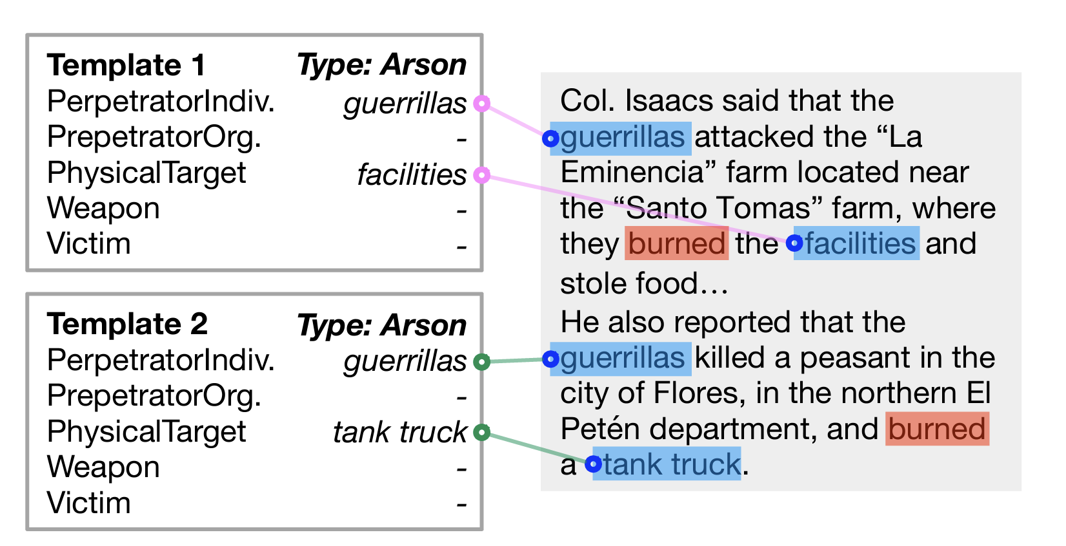
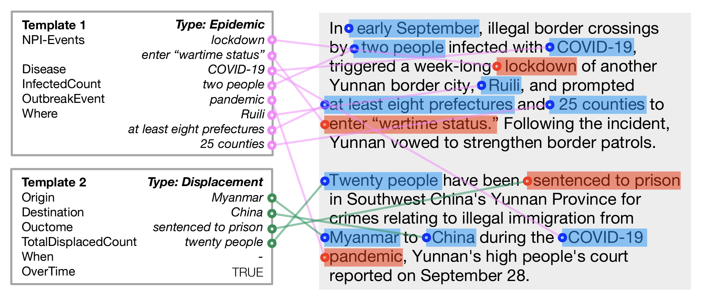
MUC-4 Ontology
arson
attack
bombing
kidnapping
murder
robbery
IARPA BETTER Granular Ontology
incidents of corruption
natural disasters
human migration events
disease outbreaks or epidemics
protests or demonstrations
acts of terrorism
Chen et al. 2023

Slide 70
Challenge #3
Even for datasets annotated with highly constrained ontologies, it is hard to predict templates.

Slide 71
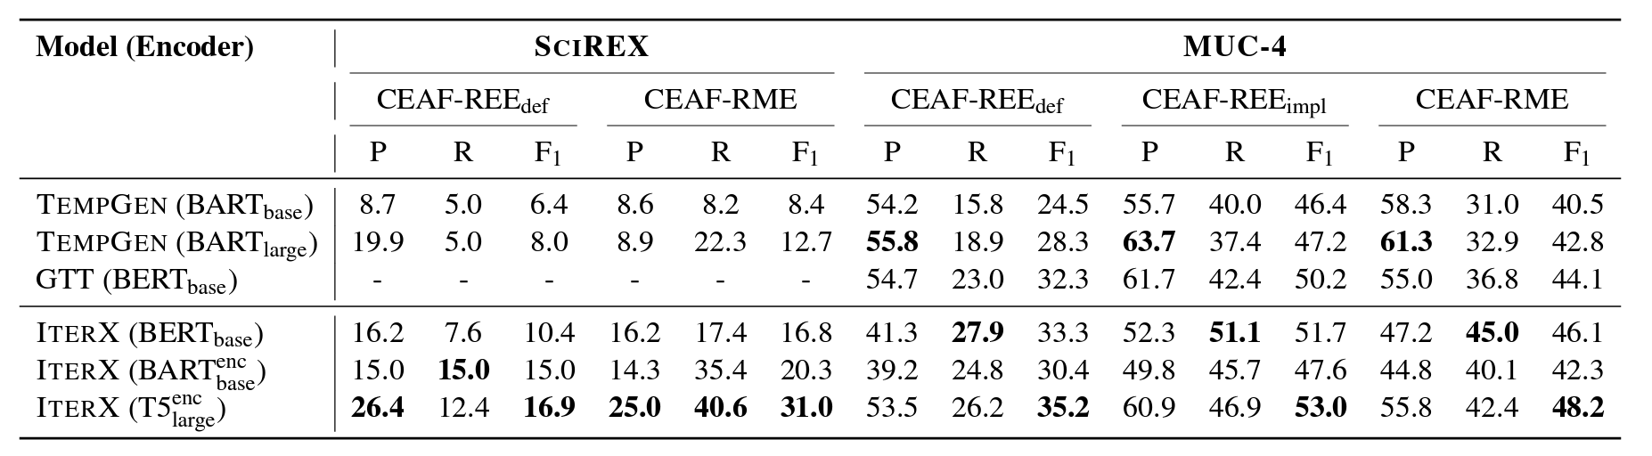
This is a hard task!
Chen et al. 2023a

Slide 72
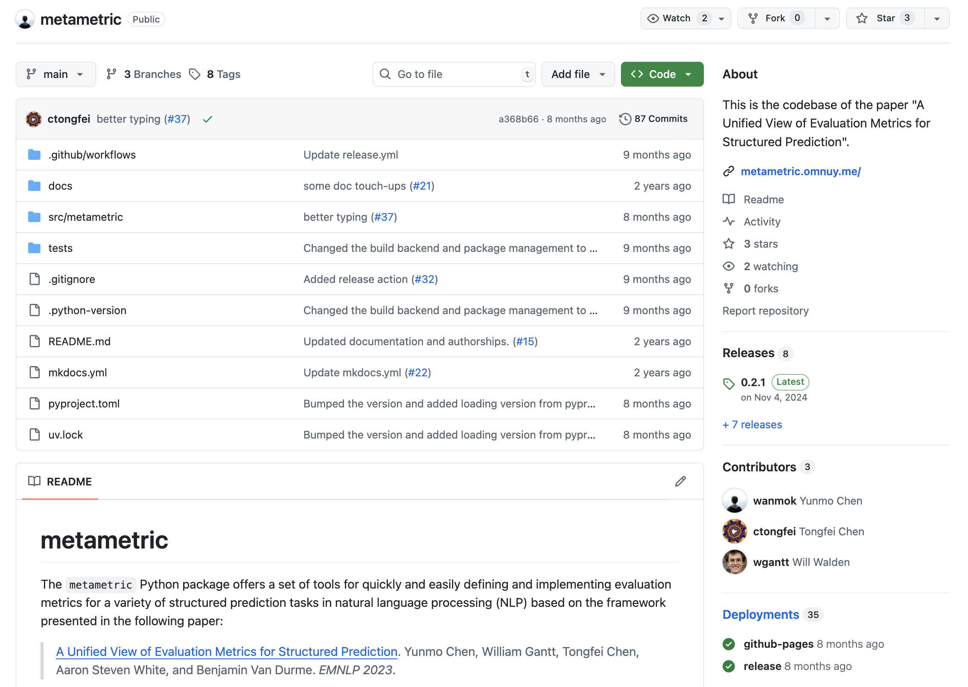
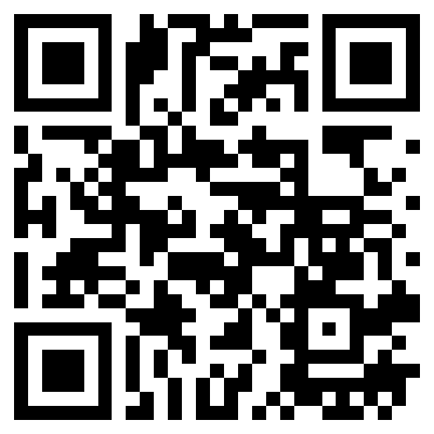
https://github.com/wanmok/metametric
Chen et al. 2023b

Slide 73
Challenge #3
Even for datasets annotated with highly constrained ontologies, it is hard to predict templates.
Upshot
Need template extraction systems on broad-coverage ontologies to generate interesting candidate inferences.

Slide 74
Template Filling
Event individuation

Slide 75
Challenge
Difficult for annotators to agree on how many instances of a particular complex situation type are described by text.

Slide 76
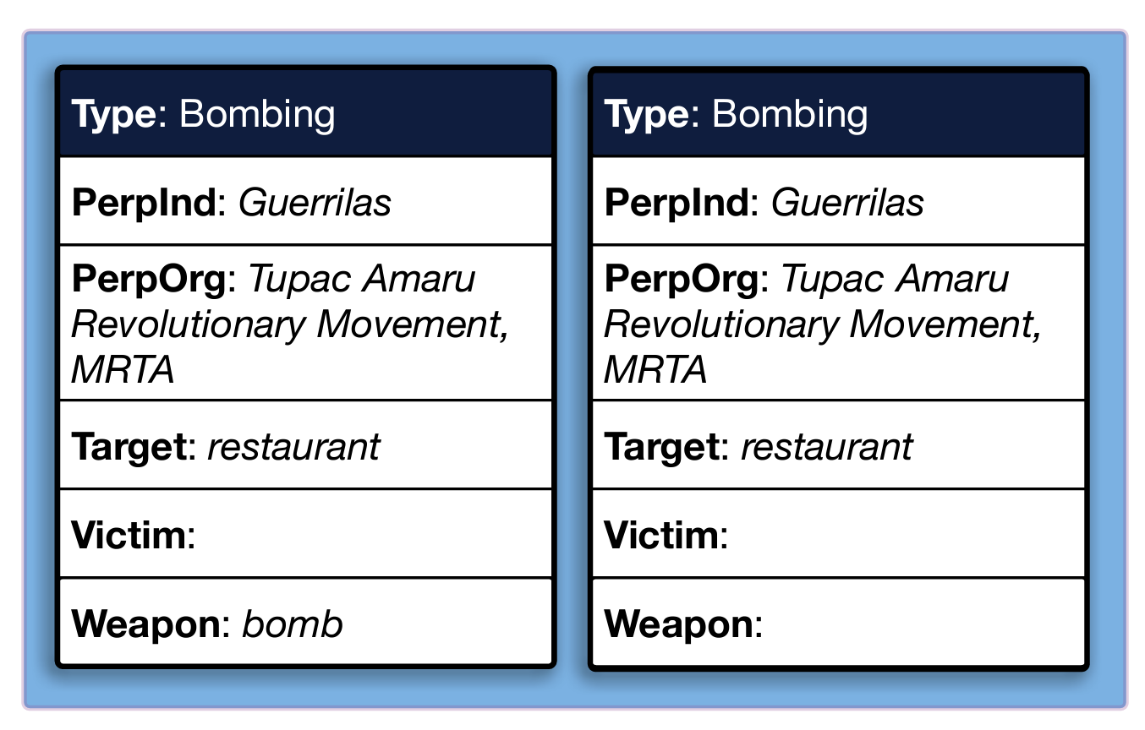
A bomb exploded today in a Lima restaurant, and a second device that had been placed in the same establishment was deactivated by the Peruvian National Police. There were no victims, and the explosion caused very little damage to the restaurant…Guerrillas of the Tupac Amaru Revolutionary Movement (MRTA) have claimed credit for the terrorist act….
Gantt et al. 2023

Slide 77
Approach
Have three experts reannotate portions of the MUC-4 and BETTER data for number of instances of a template.
Evaluation
Compare agreement among experts annotations and with gold annotation.

Slide 78
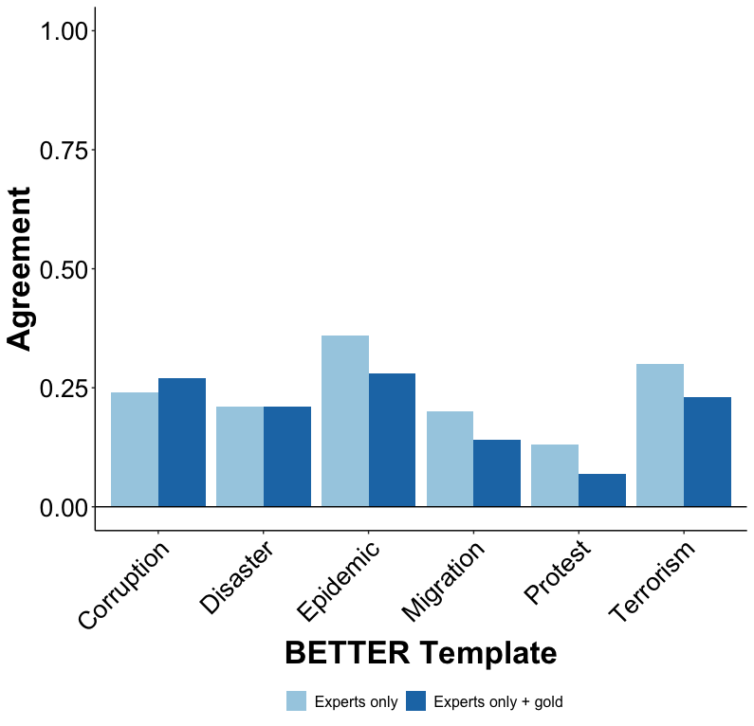
Gantt et al. 2023

Slide 79
Challenge
Difficult for annotators to agree on how many instances of a particular complex situation type are described by text.
Approach: Cross-doc argument extraction*
Explicitly point to a complex situation description in one document and fill a template for it in another.
*Related to but distinct from similar tasks like Event Linking (Nothman 2012), Cross-Document Event Coreference (Bagga and Baldwin 1999, Cybulska and Vossen 2014, (Eirewetal. 2021,2022), and Predicate-Argument Alignment (Roth and Franke 2012, Wolfe et al. 2013, 2015).

Slide 80
Template Filling
Cross-document argument extraction

Slide 81
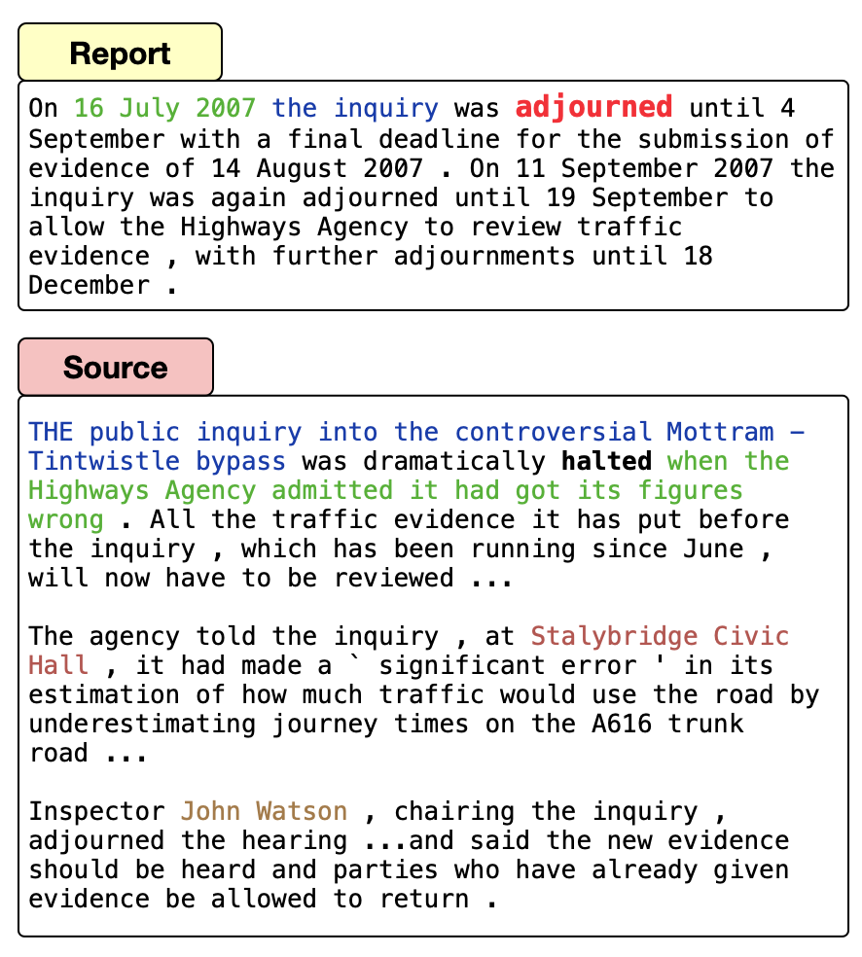
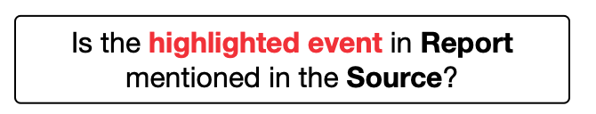
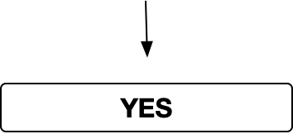
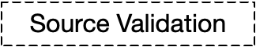
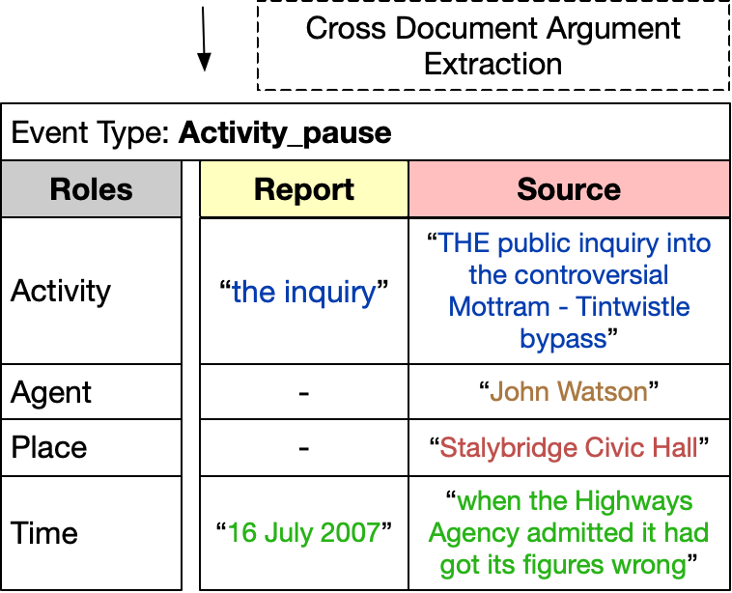
Data available at: https://github.com/FACTSlab/FAMuS
Vashishtha et al. 2023

Slide 82
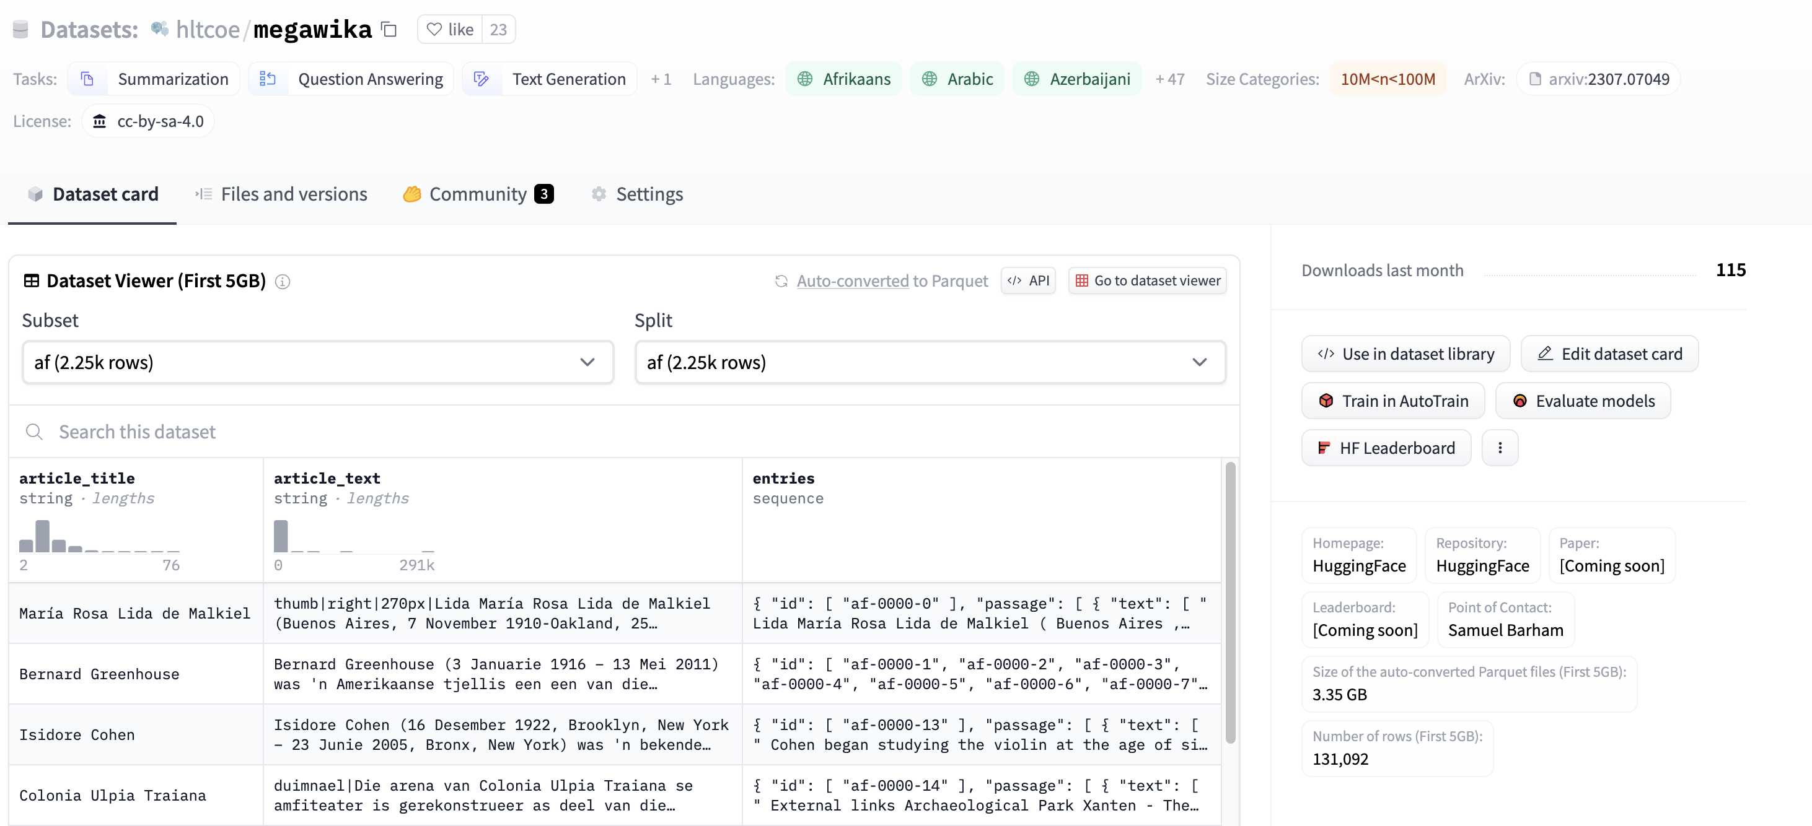
Base Corpus
Barham et al. 2023
MegaWika: >71 million source-report pairs over 50 diverse languages
Available at https://huggingface.co/datasets/hltcoe/megawika

Slide 83
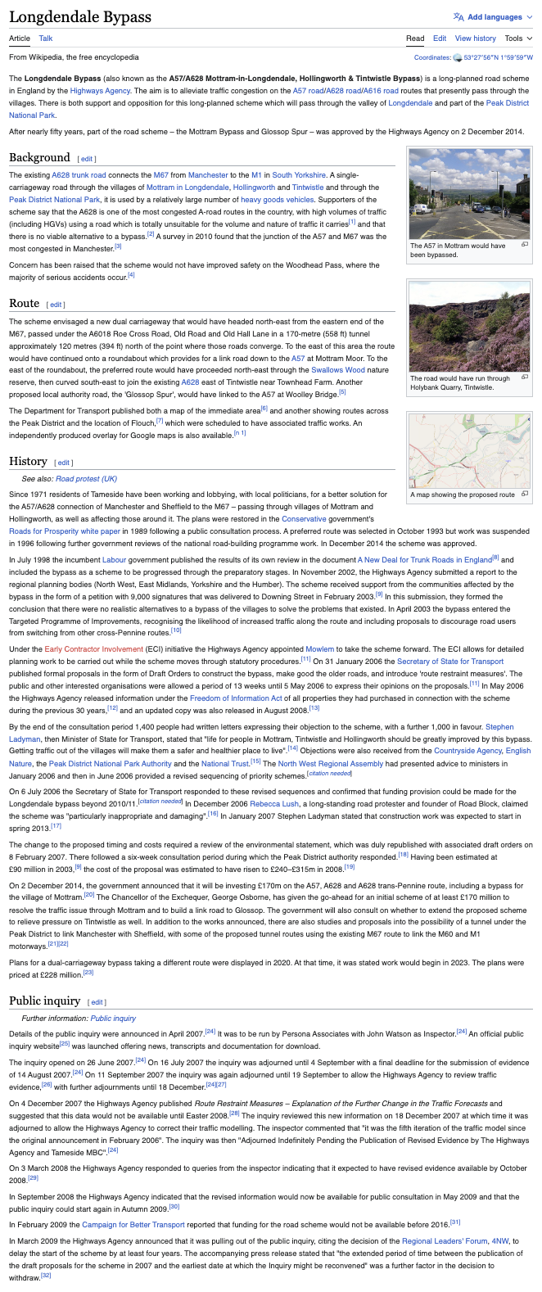
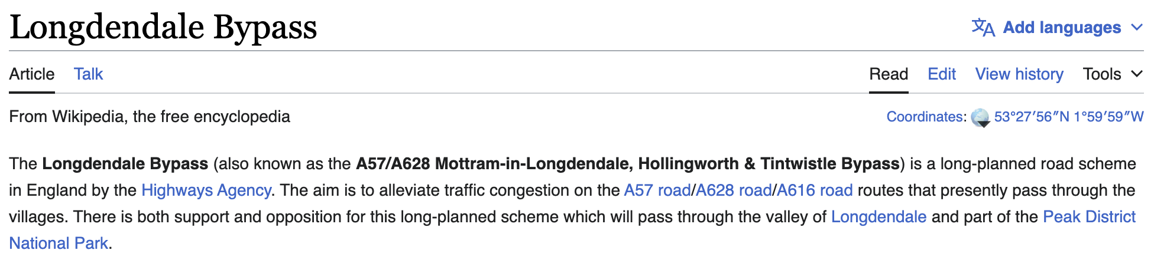
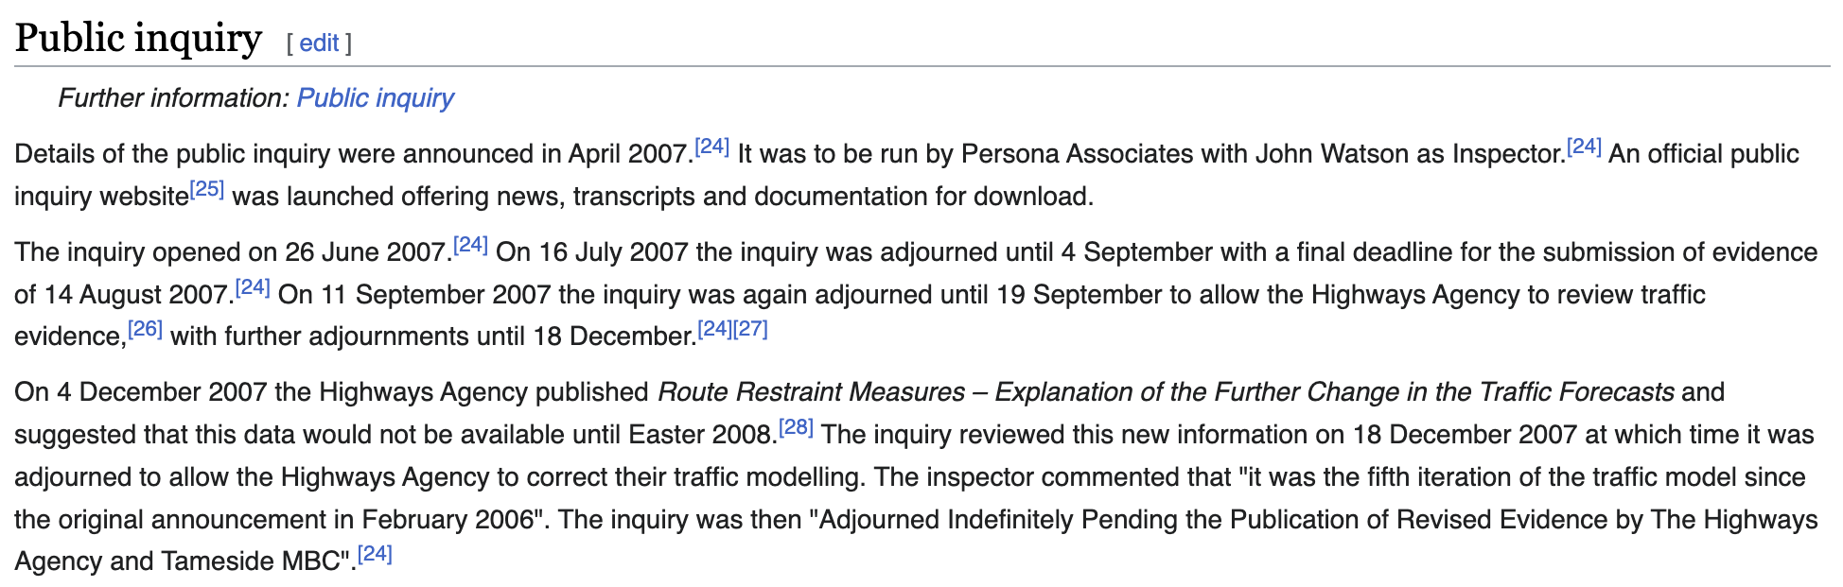
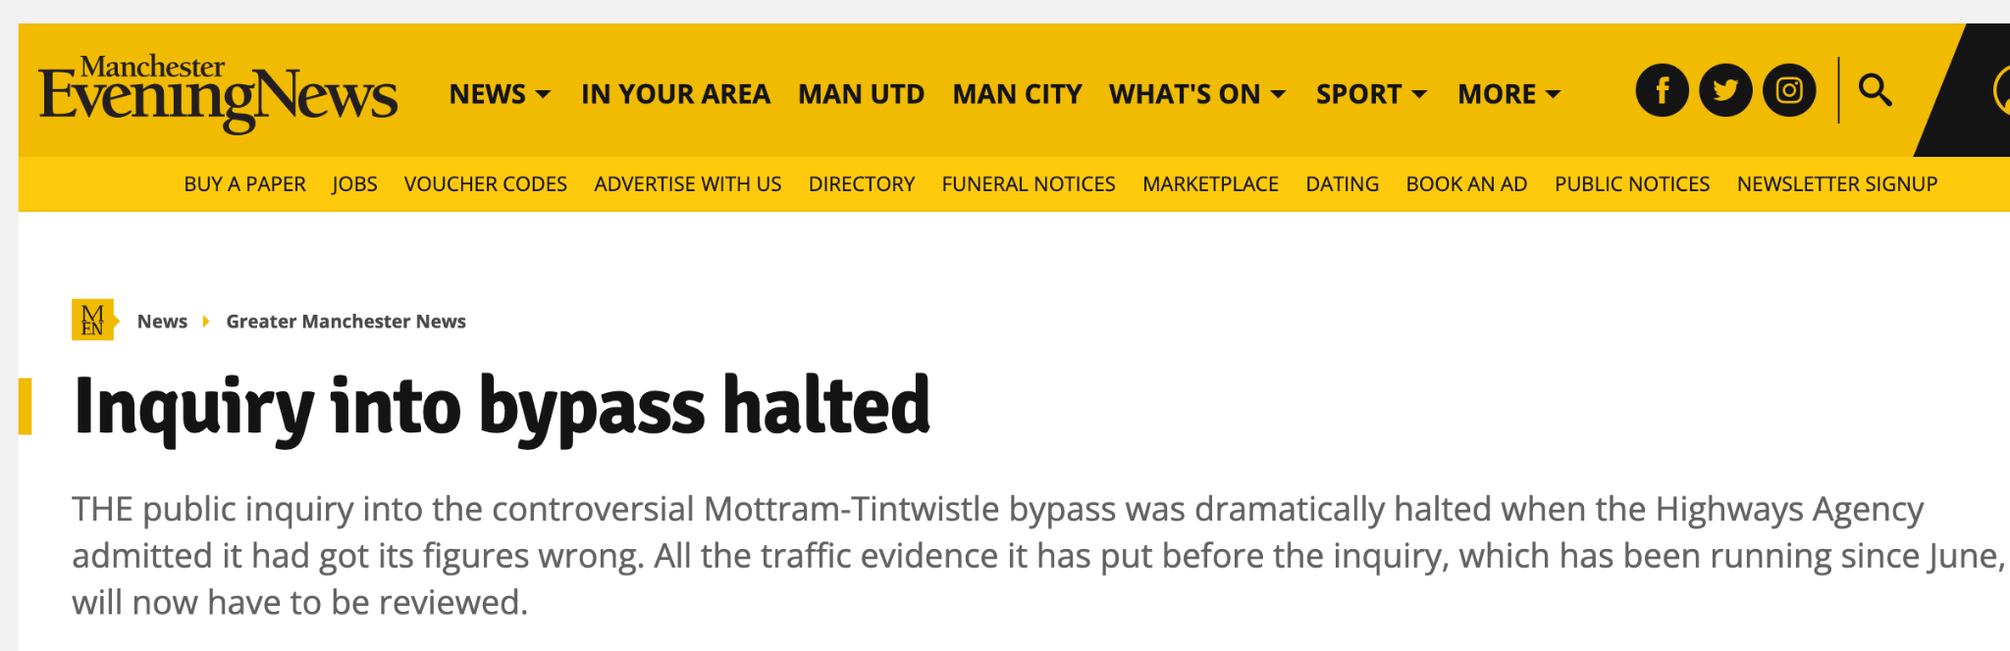
Barham et al. 2023

Slide 84
Corpus
Barham et al. 2023
MegaWika: >71 million source-report pairs over 50 diverse languages
Ontology
FrameNet as the underlying event ontology for broad-coverage of situation types (events, states, processes).
*Related to but distinct from similar tasks like Event Linking (Nothman 2012), Cross-Document Event Coreference (Bagga and Baldwin 1999, Cybulska and Vossen 2014, (Eirewetal.,2021,2022), and Predicate-Argument Alignment (Roth and Franke 2012, Wolfe et al. 2013, 2015).

Slide 85
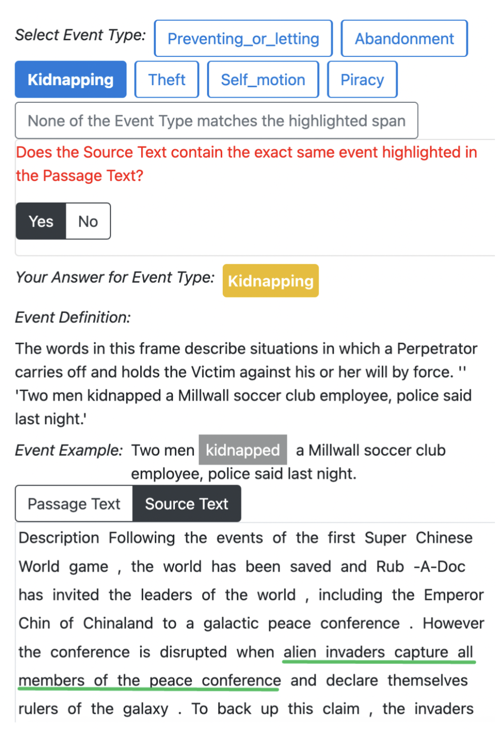
Source Validation
255 situation types from FrameNet
- 5 positive source validation (SV) examples for each event type - 5 negative source validation (SV) examples for each event type

Slide 86
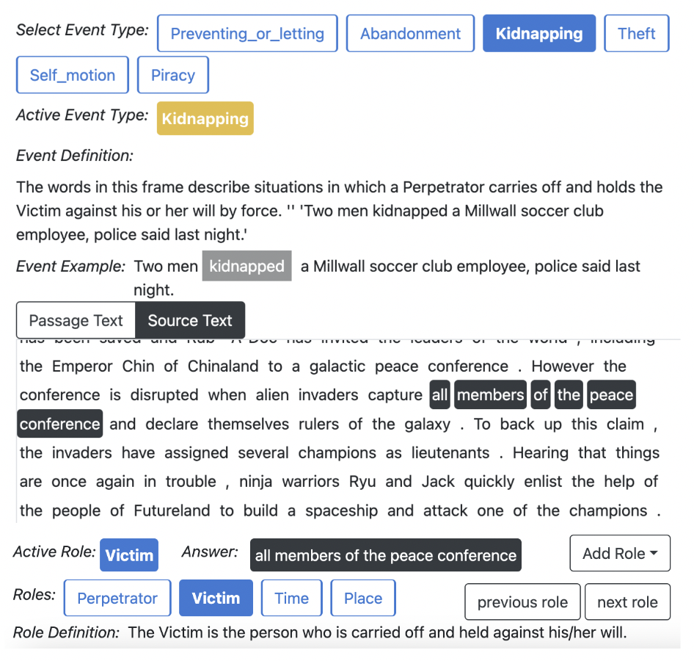
Cross-Document Argument Extraction
For each positive source validation, annotate roles in report and source.

Slide 87
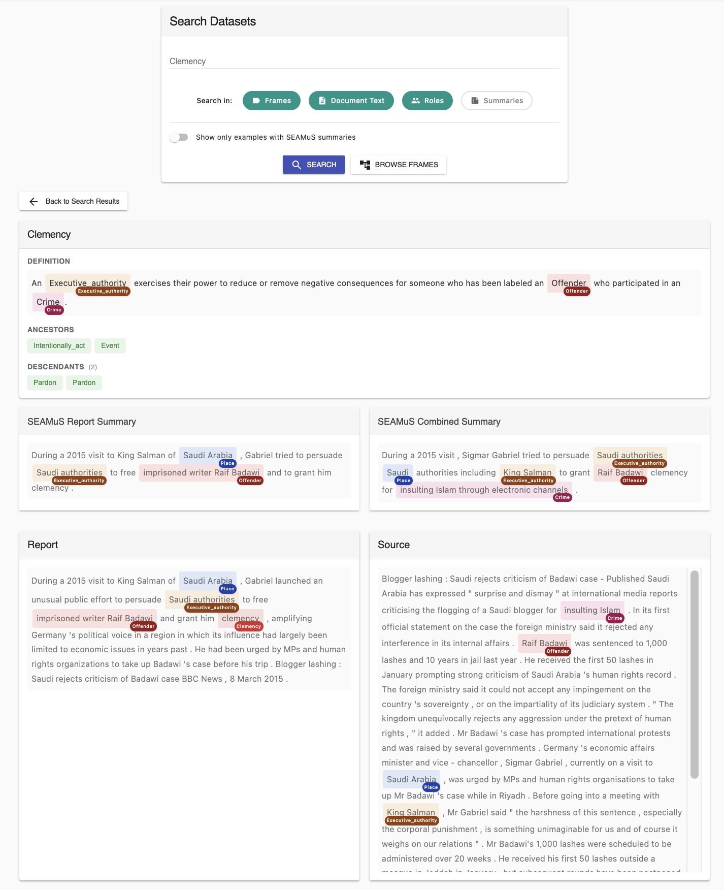
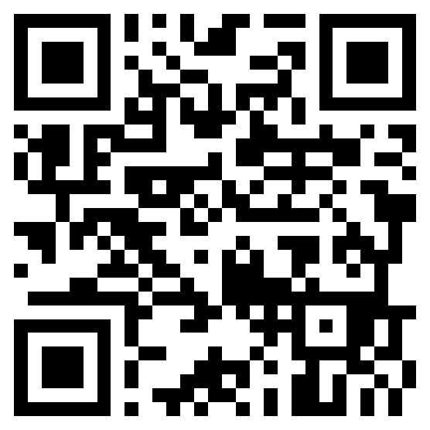
https://staramus.github.io/

Slide 88
Baselines: Source Validation
Lemma: target lemma is found in the source.
Longformer: document pair classifier
ChatGPT: prompt-based
Vashishtha et al. 2023

Slide 89
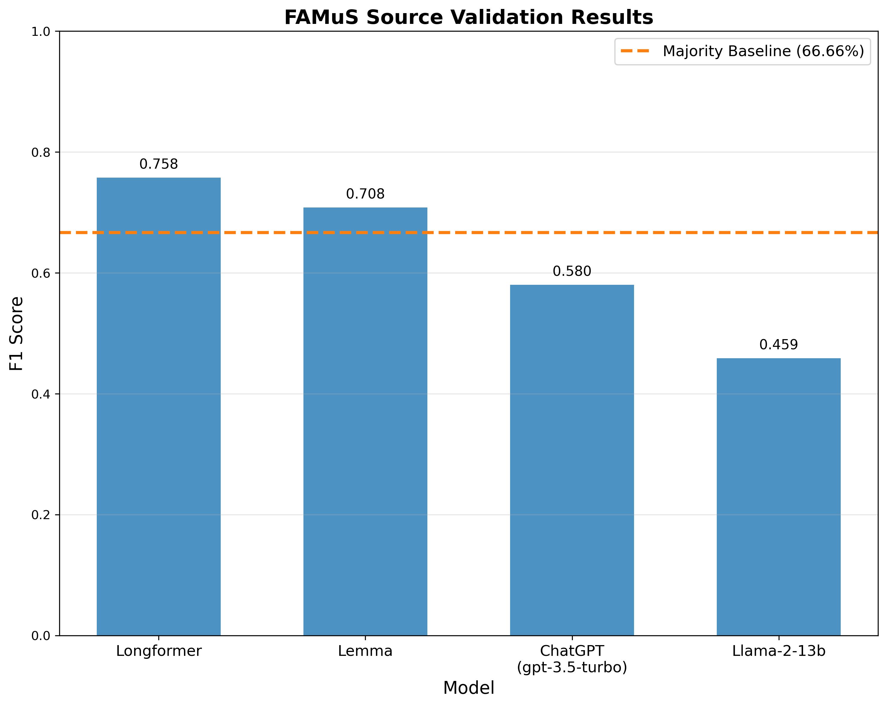

Slide 90
Baselines: Source Validation
Lemma: target lemma is found in the source.
Longformer: document pair classifier
ChatGPT: prompt-based
Baselines: Cross-Doc Argument Extraction
Report: ignore the source and use spans from report
IterX: structured prediction model
Longformer-QA: fine-tuned QA model
ChatGPT and Llama2: few-shot prompting models
Vashishtha et al. 2023

Slide 91
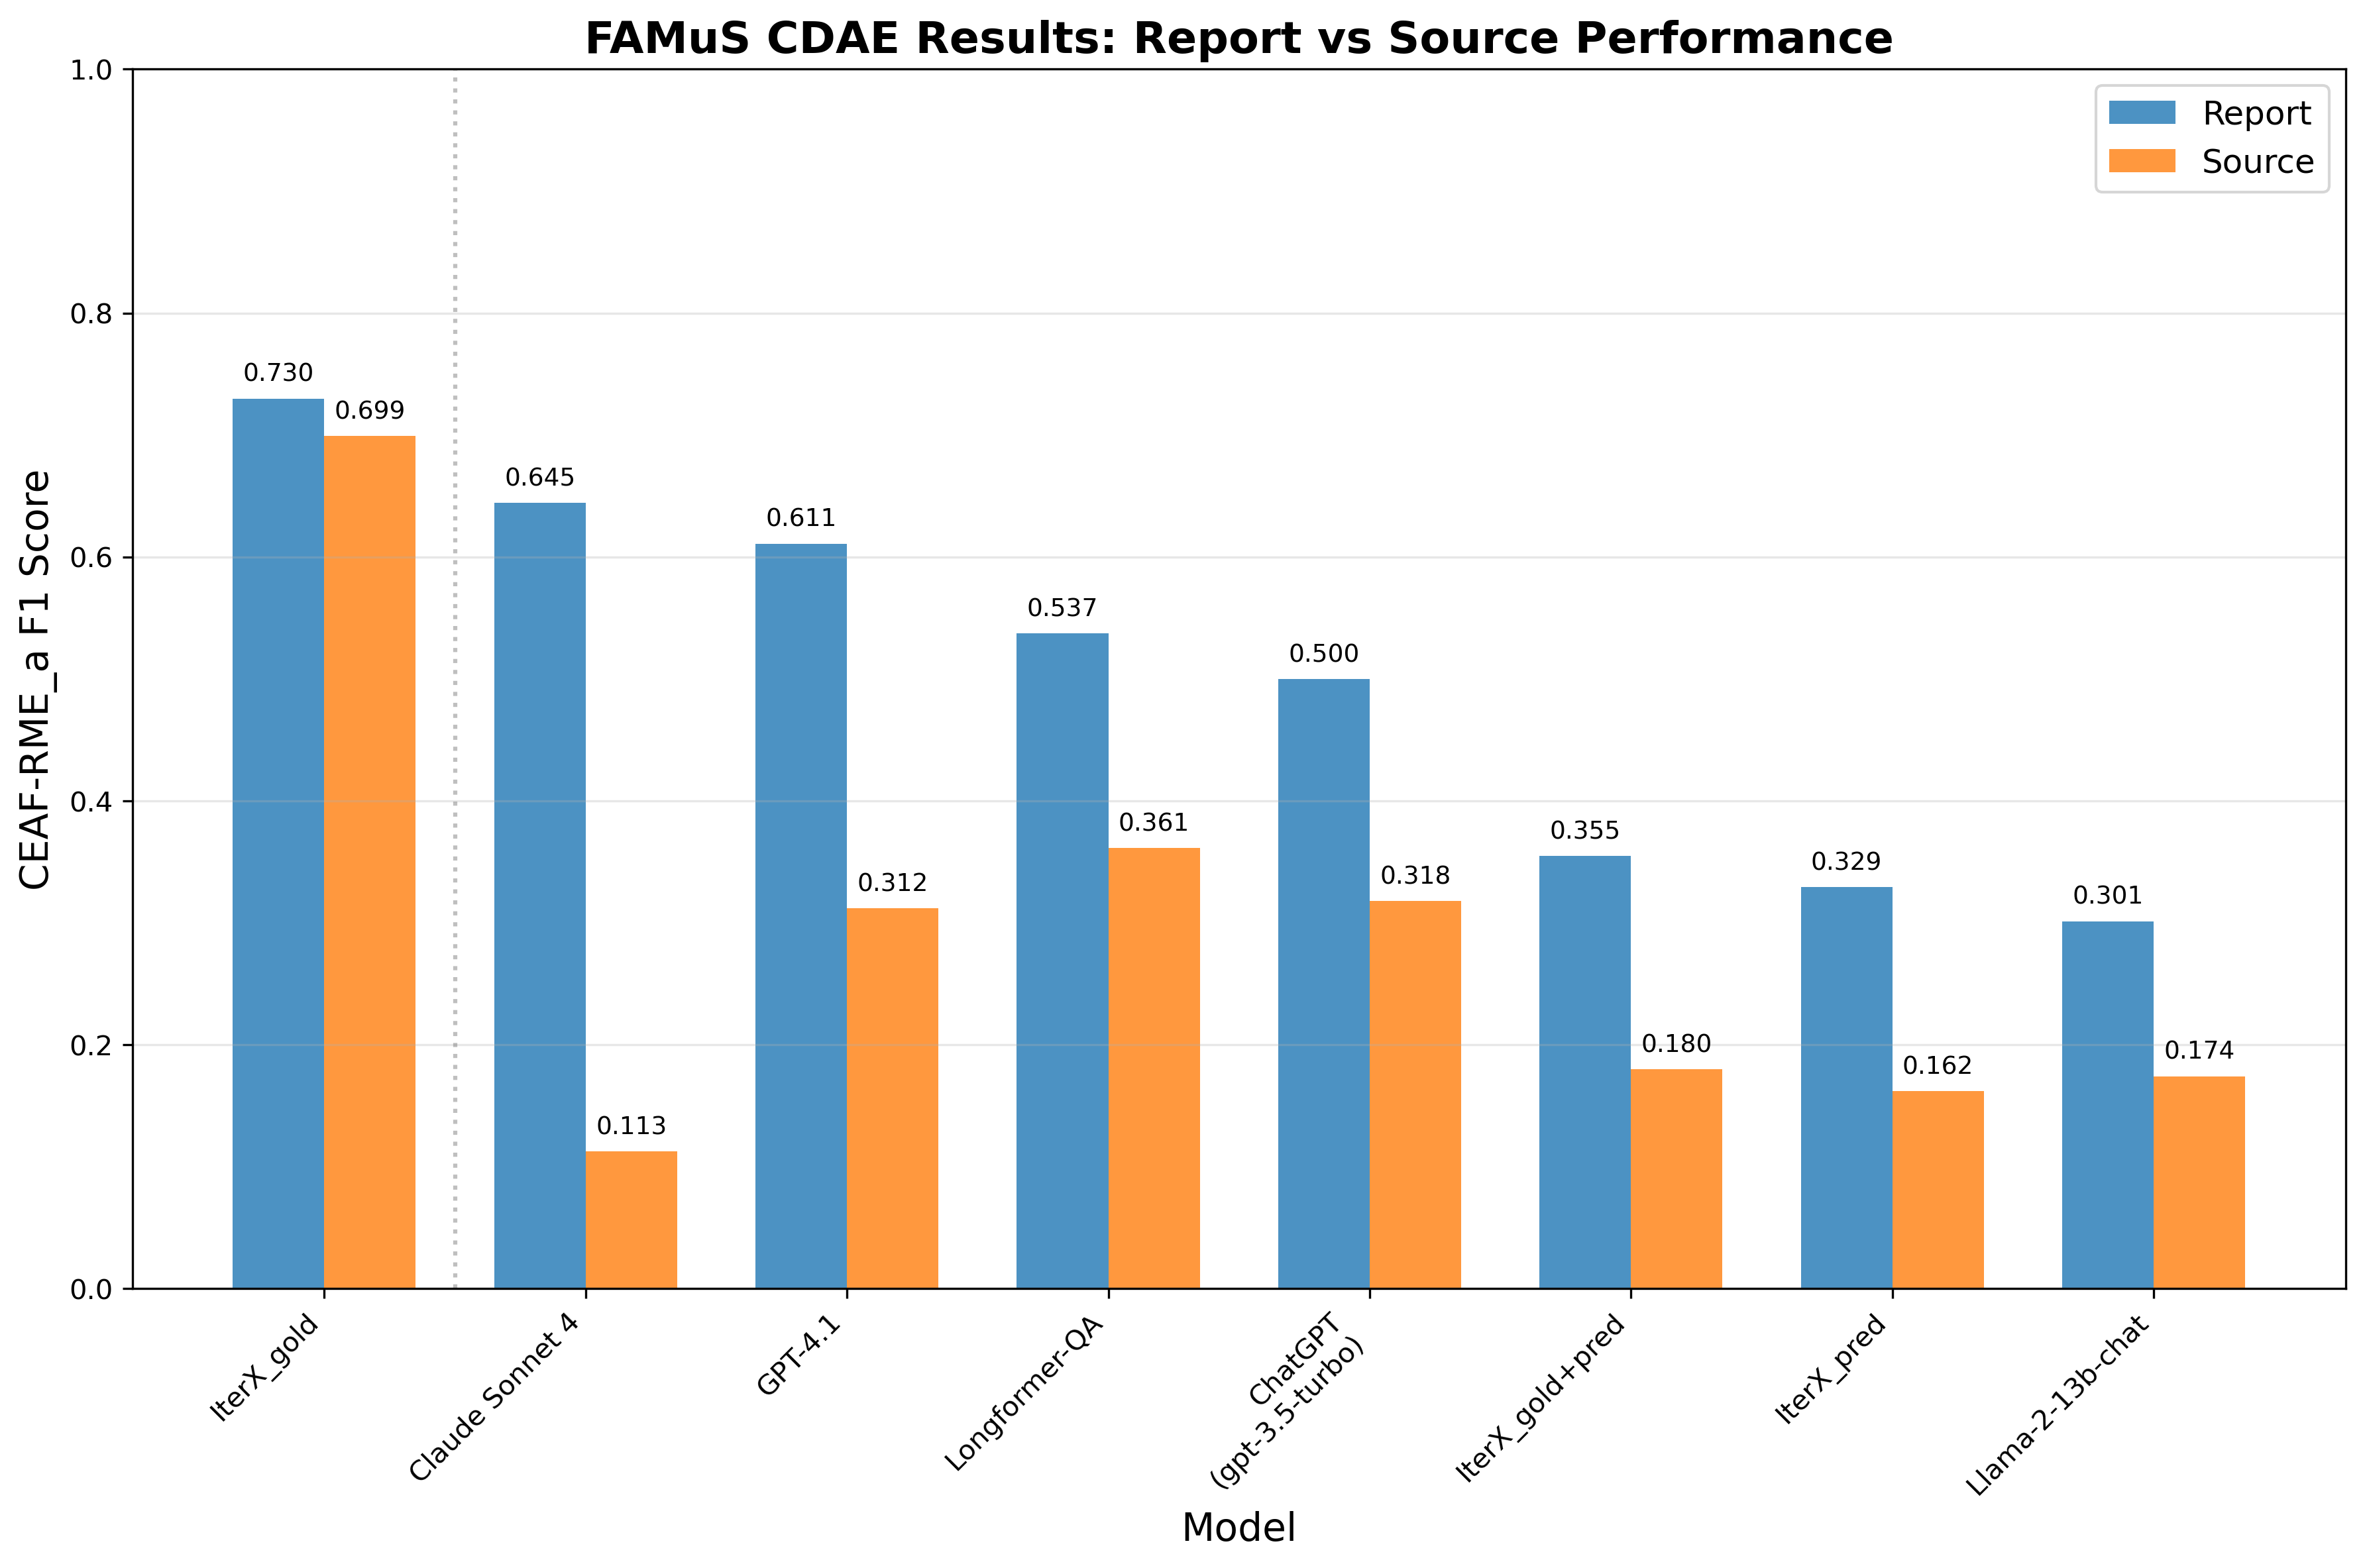

Slide 92
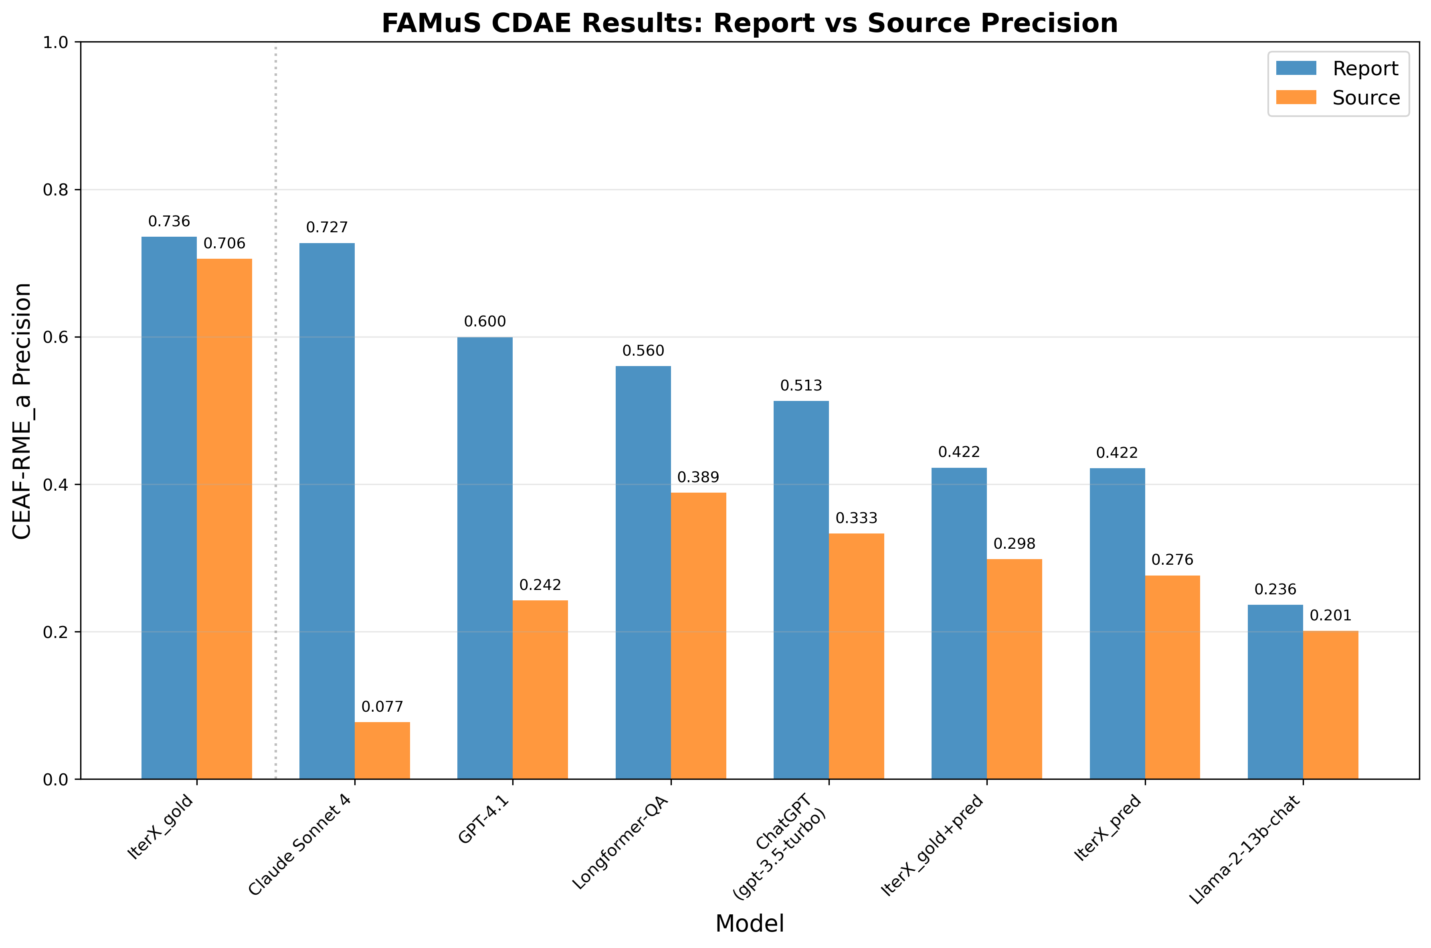

Slide 93
Template Filling
Interim Discussion

Slide 94
Finding #1
We can do broad-coverage template extraction on short documents (e.g. Wikipedia snippets) reasonably well.
Finding #2
Long-document, broad-coverage template extraction is still very hard and the better you are at short documents, the worse you are on long ones.

Slide 95
Challenge
Inferences are interesting and specific but lack sensitivity to the context of the situation description.
Idea
Generate an inference that captures the information captured by the template in a more context-sensitive way.

Slide 96
Event-Keyed Summarization

Slide 97
Goal
Leverage source-report relations to draw an inference capturing all available information relative to a template.
Idea
The template–in this case, a complex event type–is a complex query that guides inference.

Slide 99
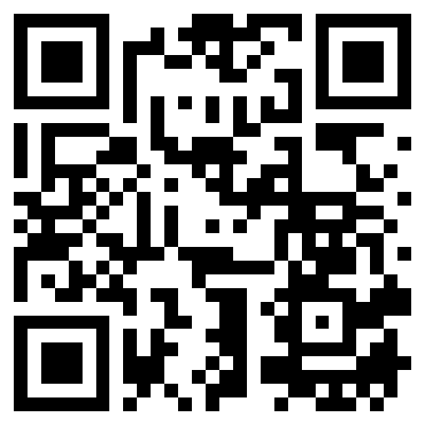
Data available at: https://github.com/wgantt/SEAMuS

Slide 100
https://staramus.github.io/

Slide 101
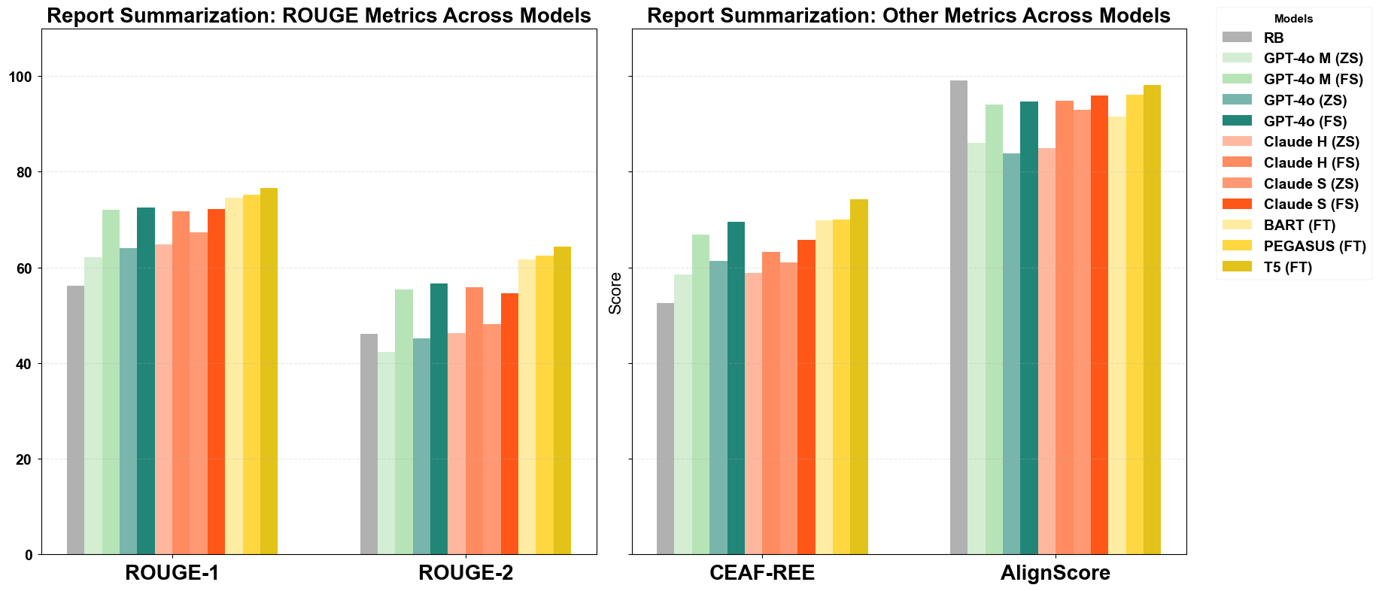

Slide 102
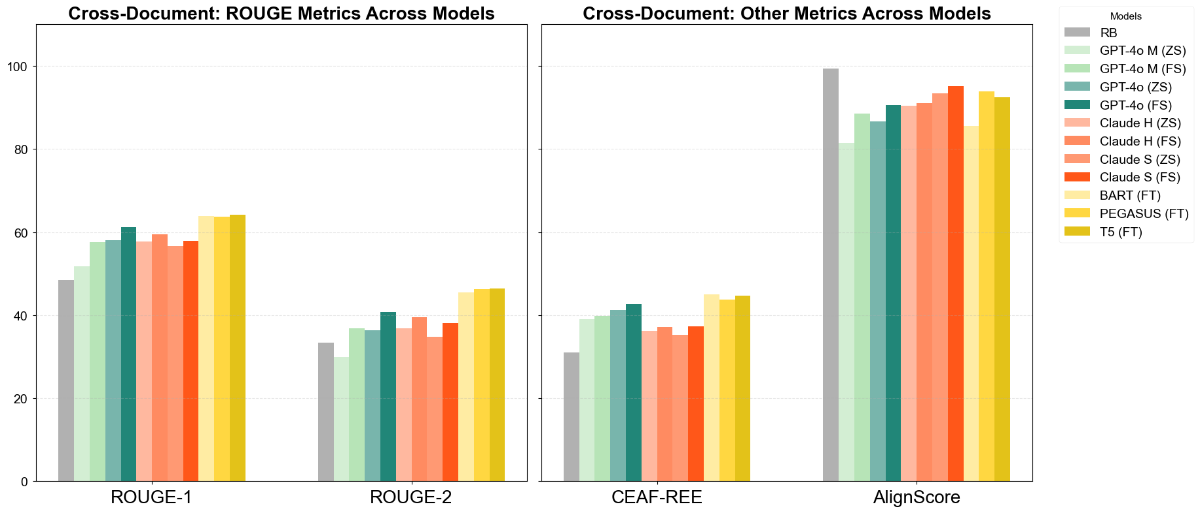

Slide 103
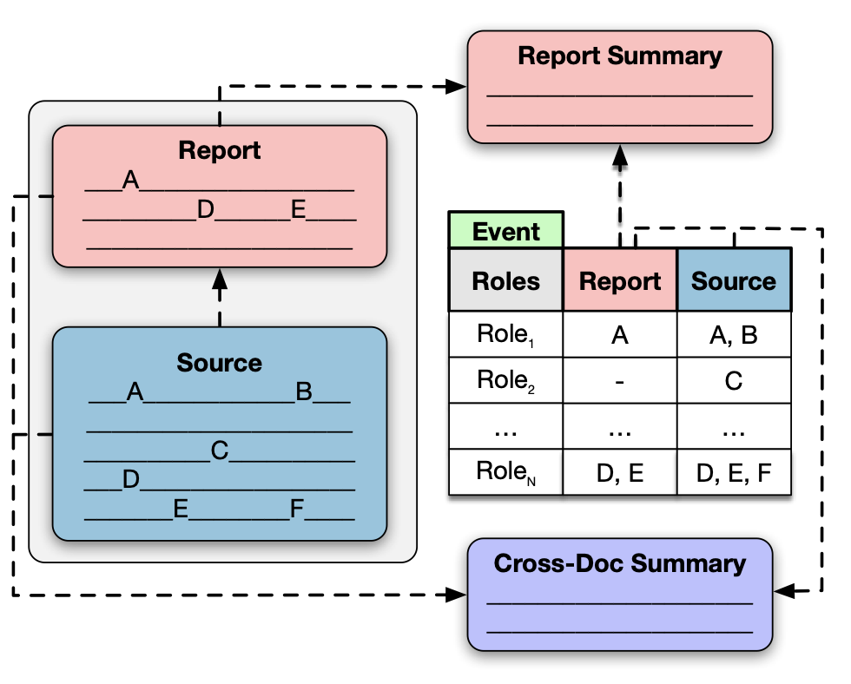
Text only: only texts
Event only: only event argument annotations
Text + Schema: only texts, name of the event per text, and corresponding roles
Text + Event: unablated setting

Slide 104
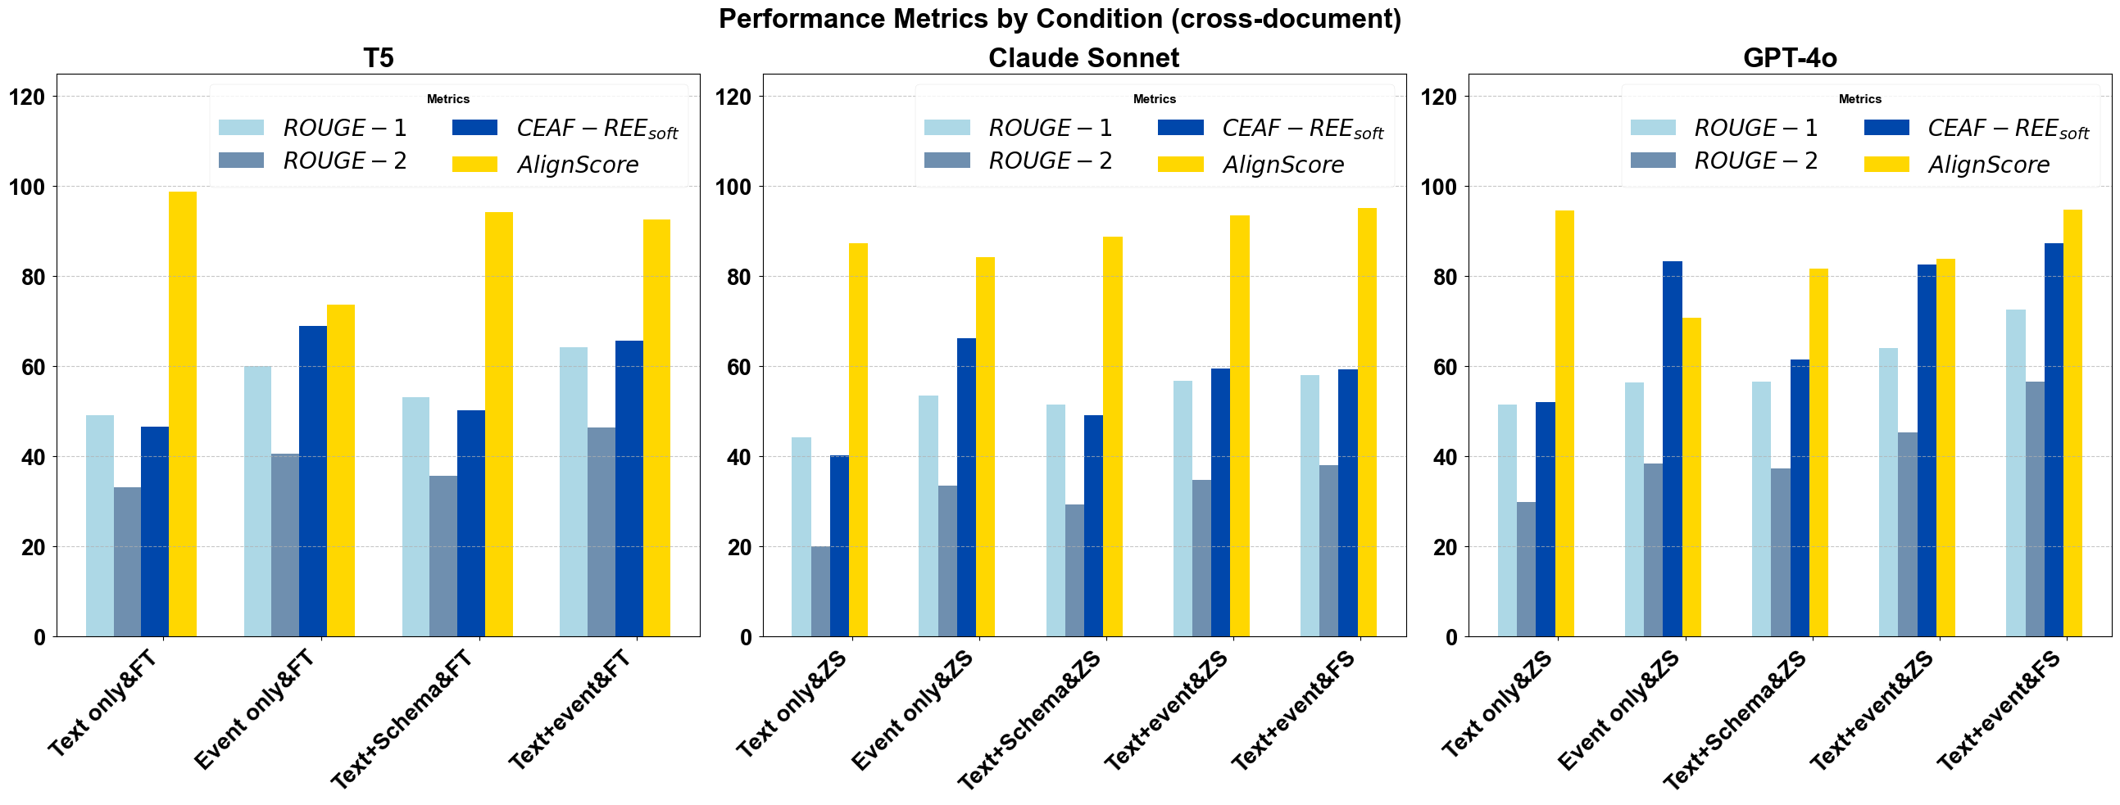

Slide 105
Conclusion

Slide 106
Question
How do we design systems that capture the inferences we draw about situations based on their descriptions?
Ontology-factored approach
Map situation description to symbolic situation ontology and draw inferences using rules stated over that ontology.

Slide 107
Challenge #1: Expense
Ontologies and annotated corpora are expensive to build and maintain because they require highly trained experts.
Challenge #2: Brittleness
Ontologies do not easily capture the ways in which context modulates the inferences that we draw.

Slide 108
Question
How do we design systems that capture the inferences we draw about situations based on their descriptions?
Ontology-factored approach
Map situation description to symbolic situation ontology and draw inferences using rules stated over that ontology.
Ontology-free approach
Map situation descriptions to natural language strings expressing the inferences of interest.

Slide 109
Ontologies as Representational Scaffolding
Ontologies provide guidance about what the interesting inferences are.
These inferences are directly associated with a text, as in ontology-free approaches.

Slide 110
Thanks!
Supported by NSF-BCS-2040831 (Computational Modeling of the Internal Structure of Events), University of Rochester, JHU HLTCOE, DARPA AIDA, DARPA KAIROS, and IARPA BETTER.

Slide 111
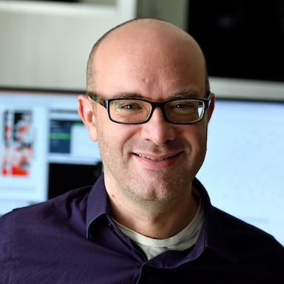


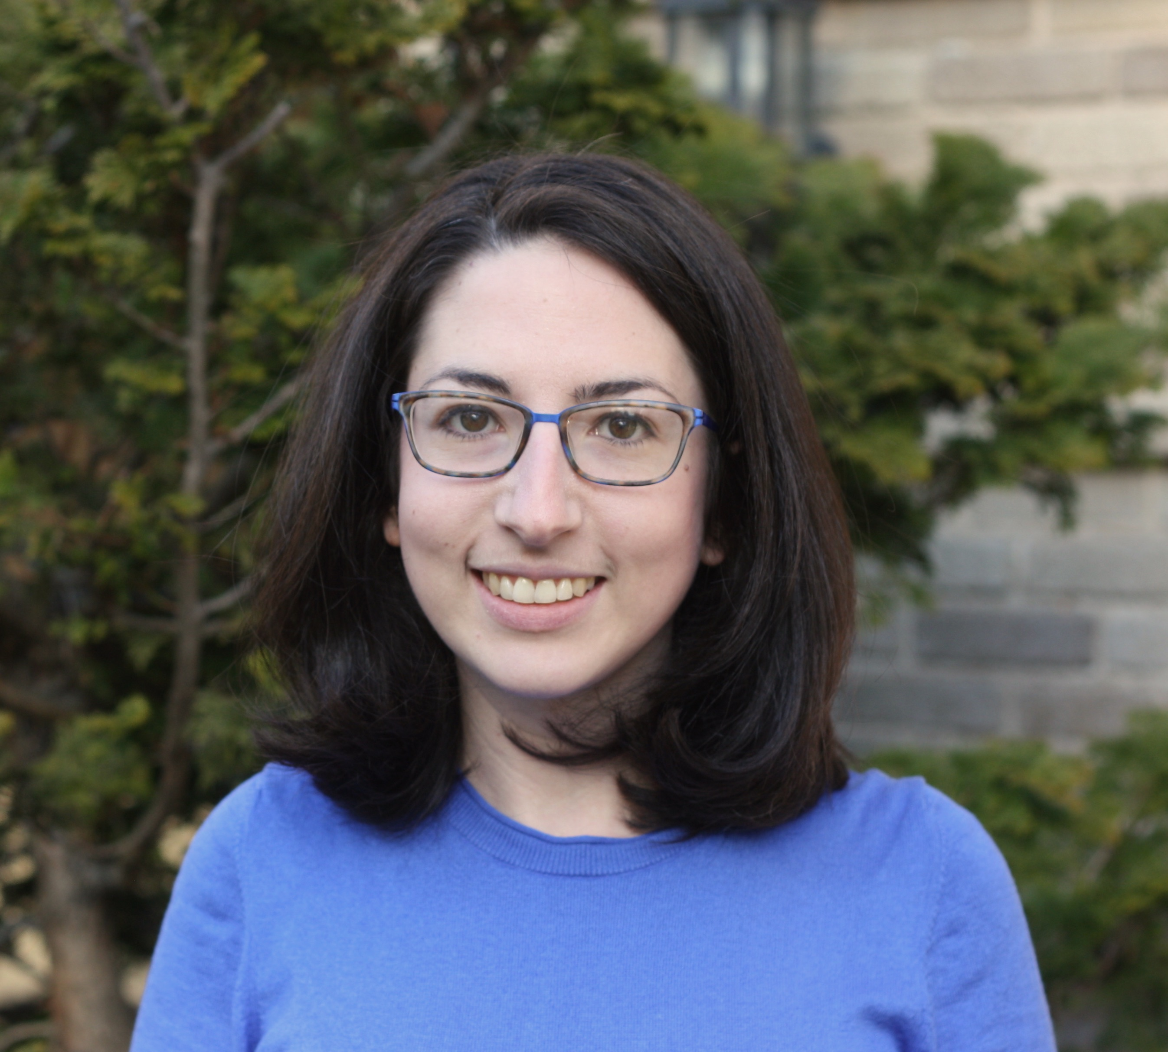
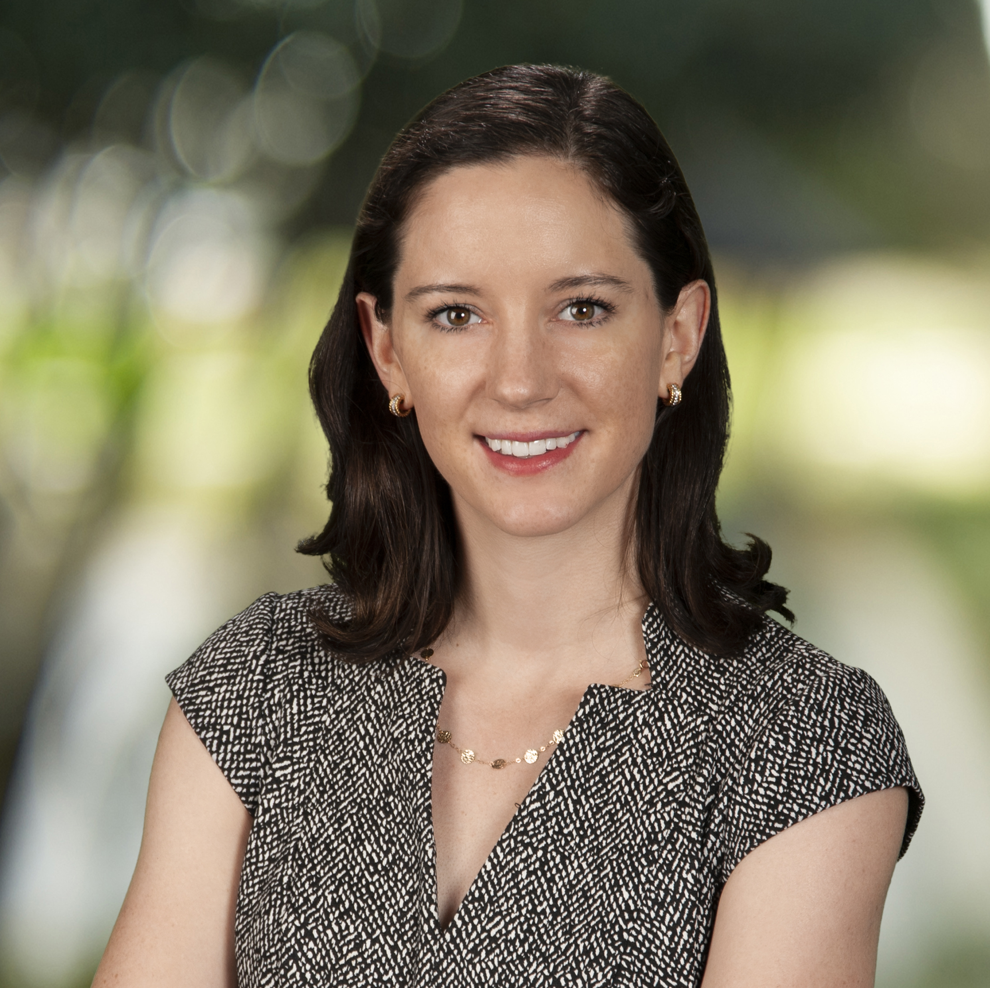
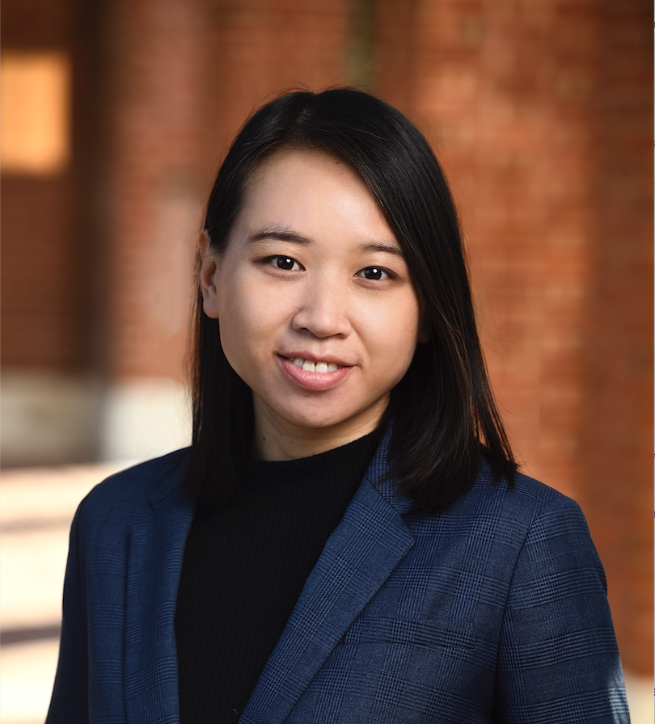


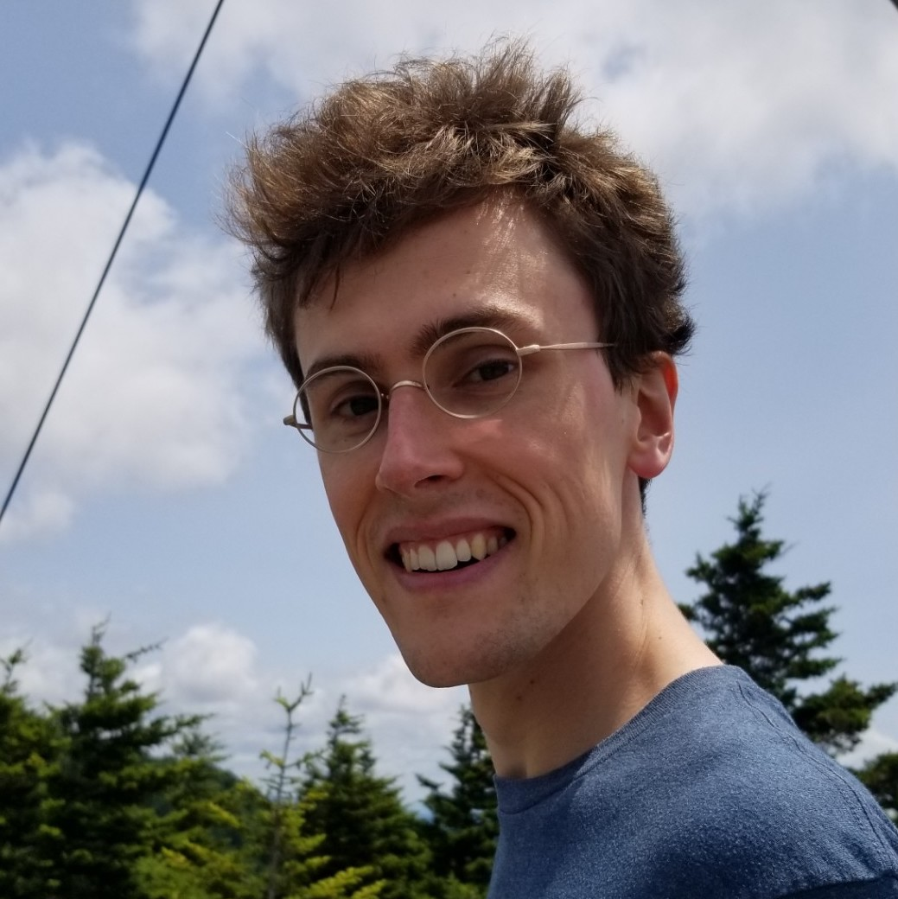



















Kyle Rawlins
JHU
Ben Van Durme
JHU
Jordan Boyd-Graber
UMD College Park
Rachel Rudinger
UMD College Park
Lelia Glass
Georgia Tech
Anqi Liu
JHU
Kevn Duh
JHU
Sid Vashishtha
DeepMind
Will Walden
JHU
Yunmo Chen
JHU
Sam Barham
JHU
Mahsa Yarmohammadi
JHU
Kenton Murray
JHU
Reno Kriz
JHU
Arsal Imtiaz
Everlaw
Chandrashekar Nair
Everlaw
Alex Martin
JHU
Weiwei Gu
ASU
Tongfei Chen
Microsoft
Venkat Govindarajan
Ithaca College
Dee Ann Reisinger
Bryn Mawr
Pushprendre Rastogi
DeepMind
Elias Stengel-Eskin
UT Austin
Sheng Zhang
Microsoft
Zhengping Jiang
JHU
Orion Weller
JHU
Michelle Yuan
UMD College Park
Adam Poliak
Barnard

